Slide 2
Respiratory System Functions
Functions of Respiratory System
Gas exchange between blood and air
Move air throughout body
Protect body from environmental hazards such as pollution, bacteria & viruses.
Produce sound
Detect scents/smells
Notes:
2

Slide 3
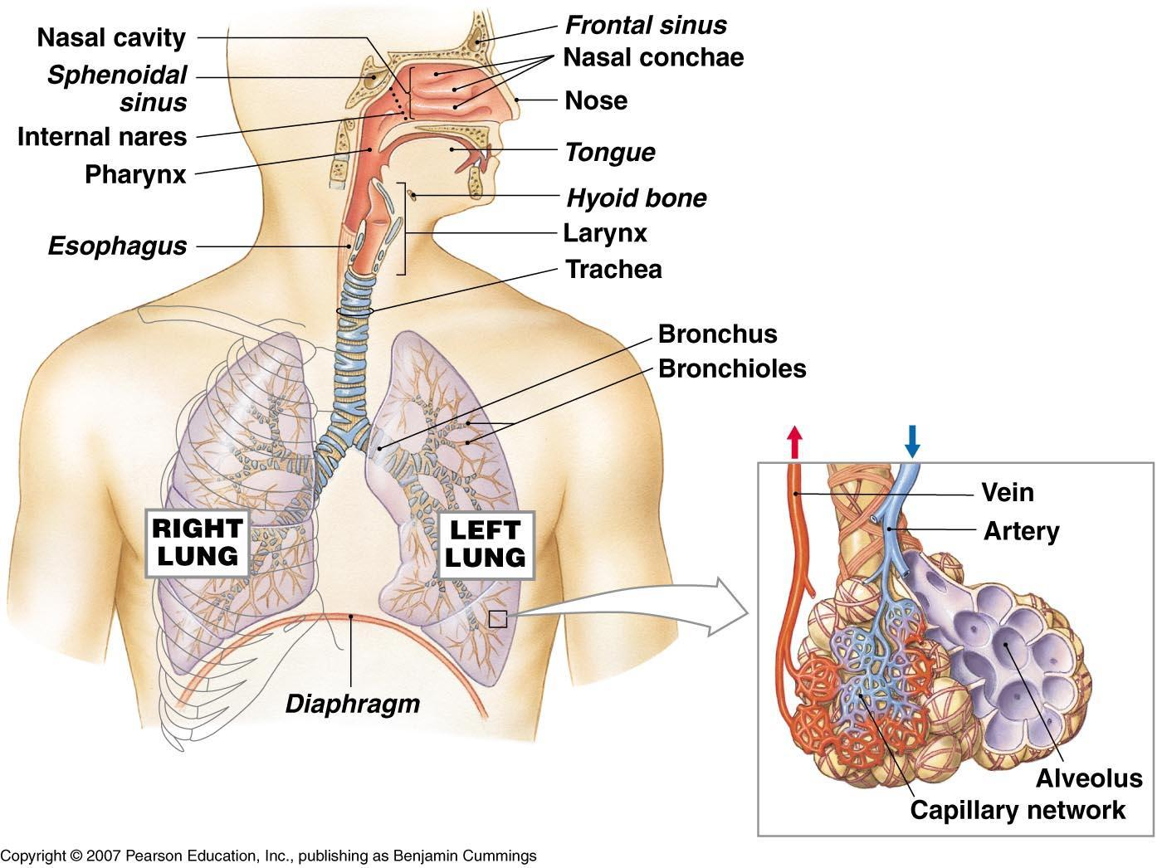
Respiratory System Organization
The Components of the Respiratory System
Notes:
3

Slide 4
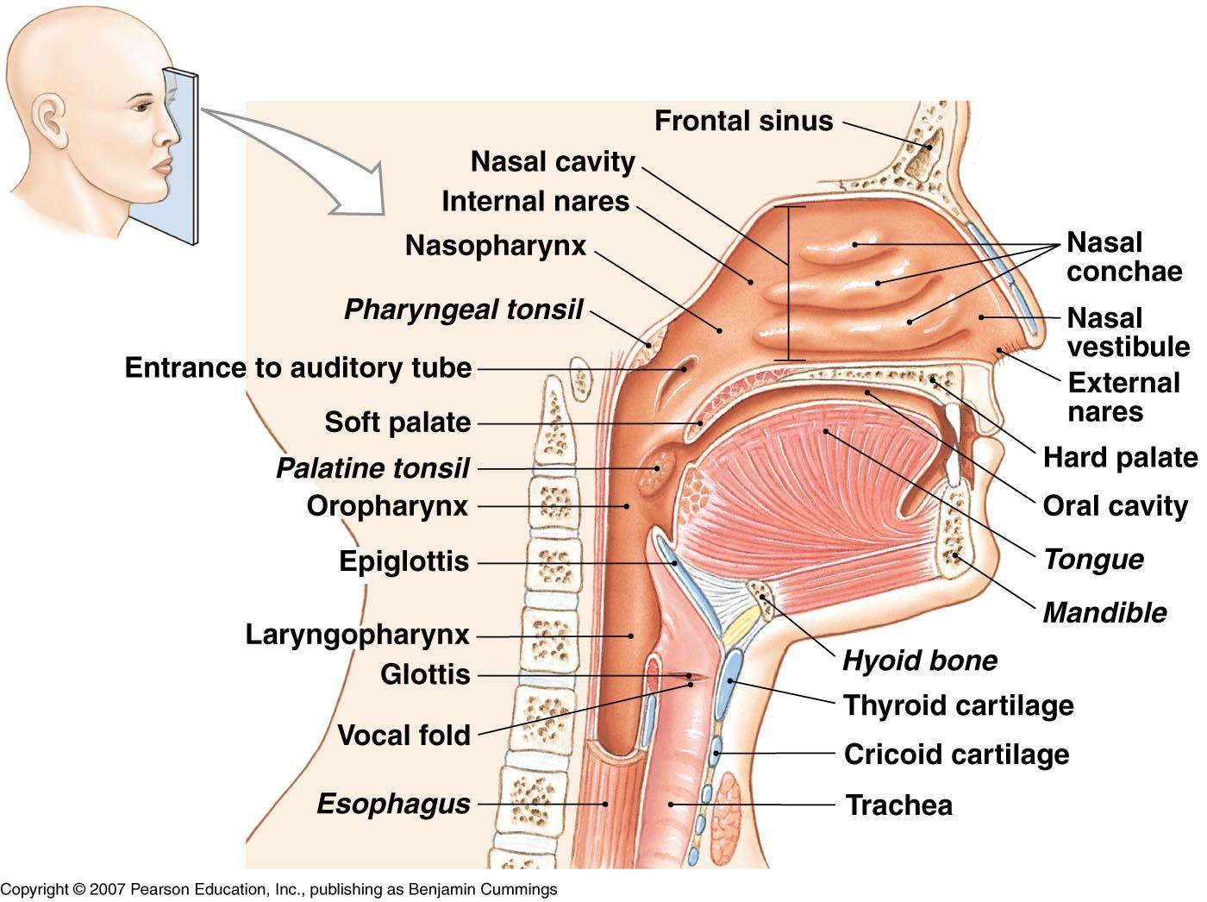
Respiratory System Organization
#1: The Nasal Cavity
External nares (nostrils) admit air
Nasal passage lined with hairs to filter air
Notes:
4

Slide 5
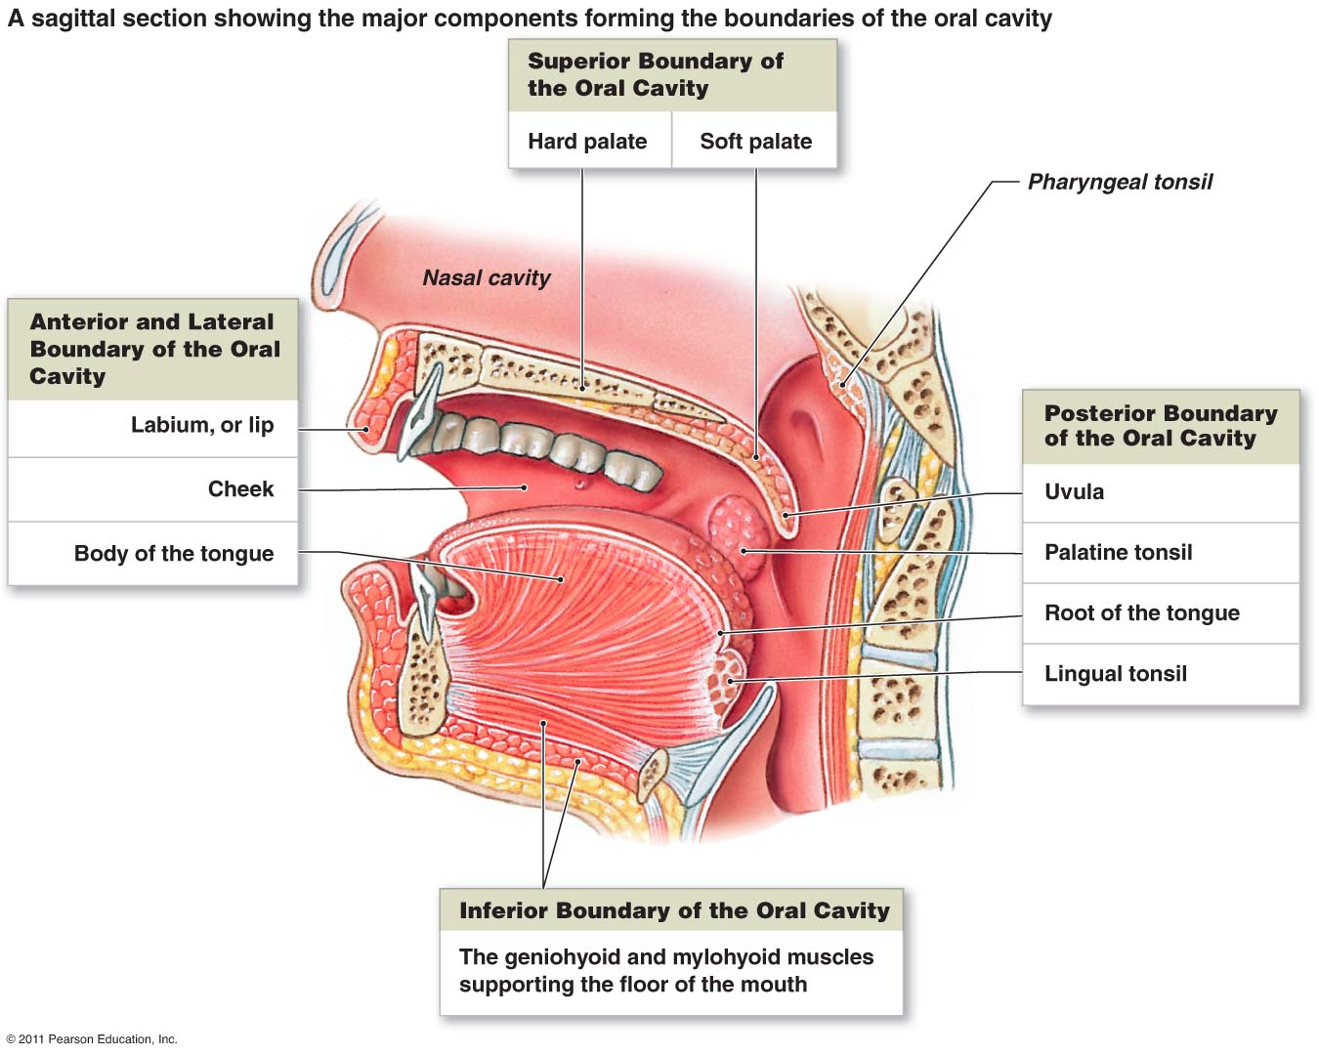
Respiratory System Organization
#2: The Mouth
Passage to admit air
Notes:
5

Slide 6
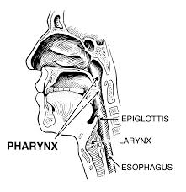
Respiratory System Organization
#7: The Pharynx (throat) – entry way for air into the body
Notes:
6

Slide 7
Respiratory System Organization
#3: The Larynx
Also called, “voice box”
Made of nine cartilages
Covered by epiglottis during swallowing
Keeps solids, liquids out of airways
Flap of tissue
Supports true vocal cords
Exhaled air vibrates them to make sound
Notes:
7

Slide 8
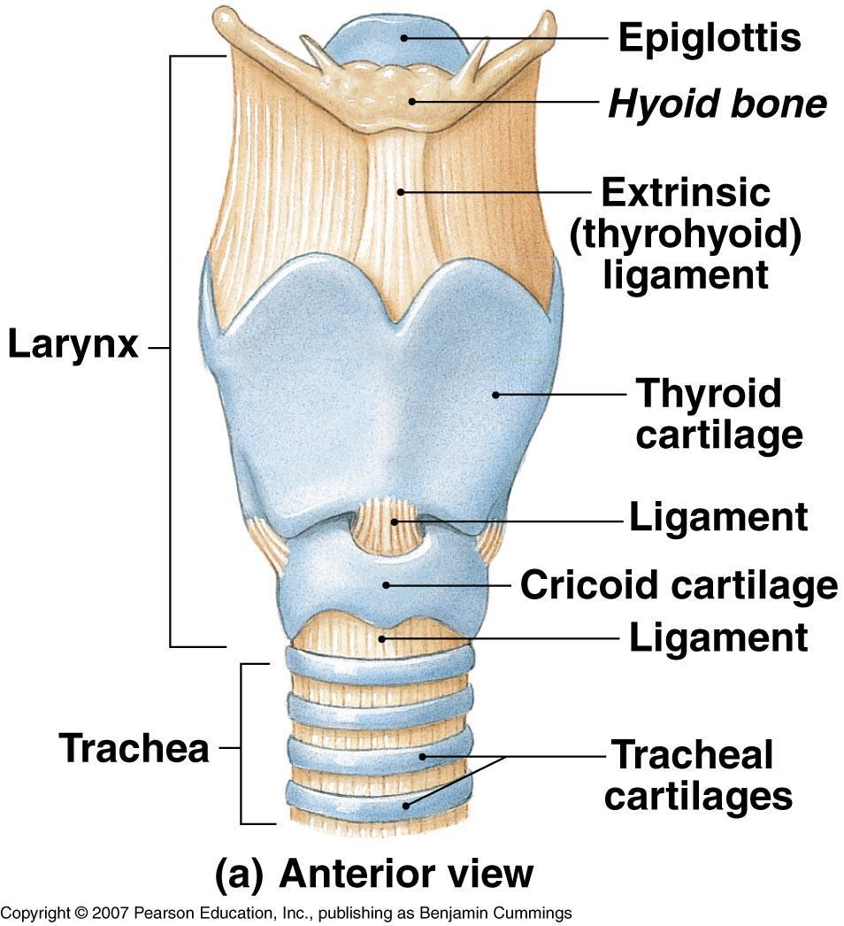
Respiratory System Organization
The Anatomy of the Larynx and Vocal Cords
Notes:
8

Slide 9
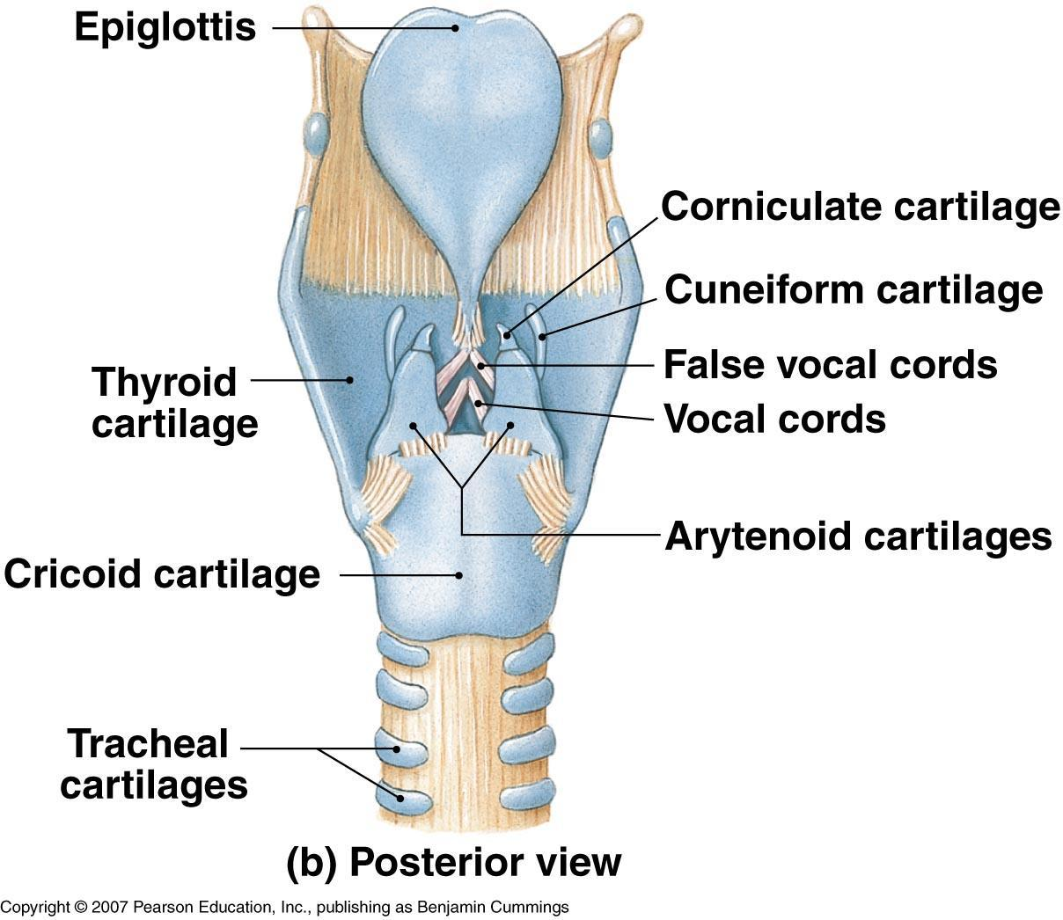
Respiratory System Organization
The Anatomy of the Larynx and Vocal Cords
Notes:
9

Slide 10
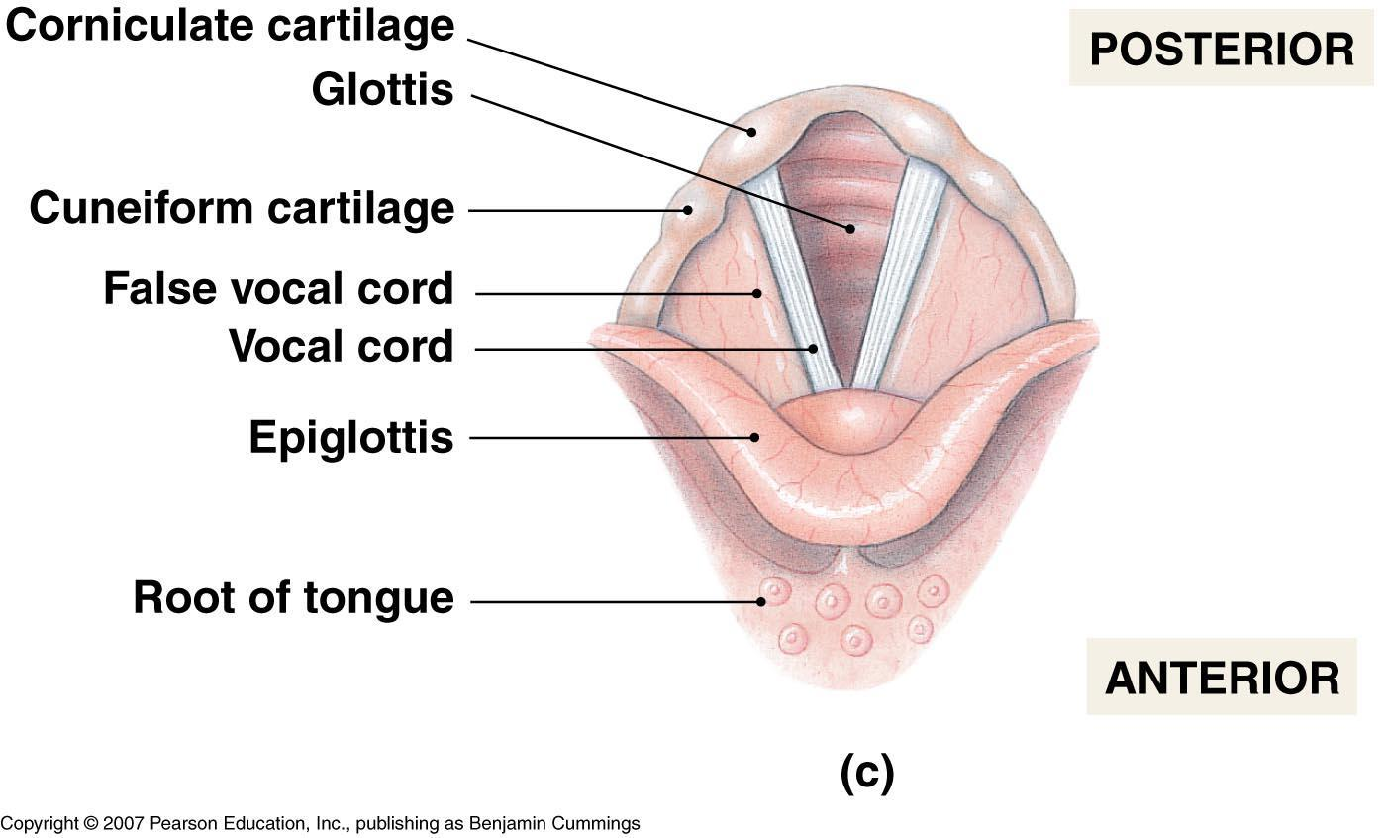
Respiratory System Organization
The Anatomy of the Larynx and Vocal Cords
Figure 15-4(c)
Notes:
10

Slide 11
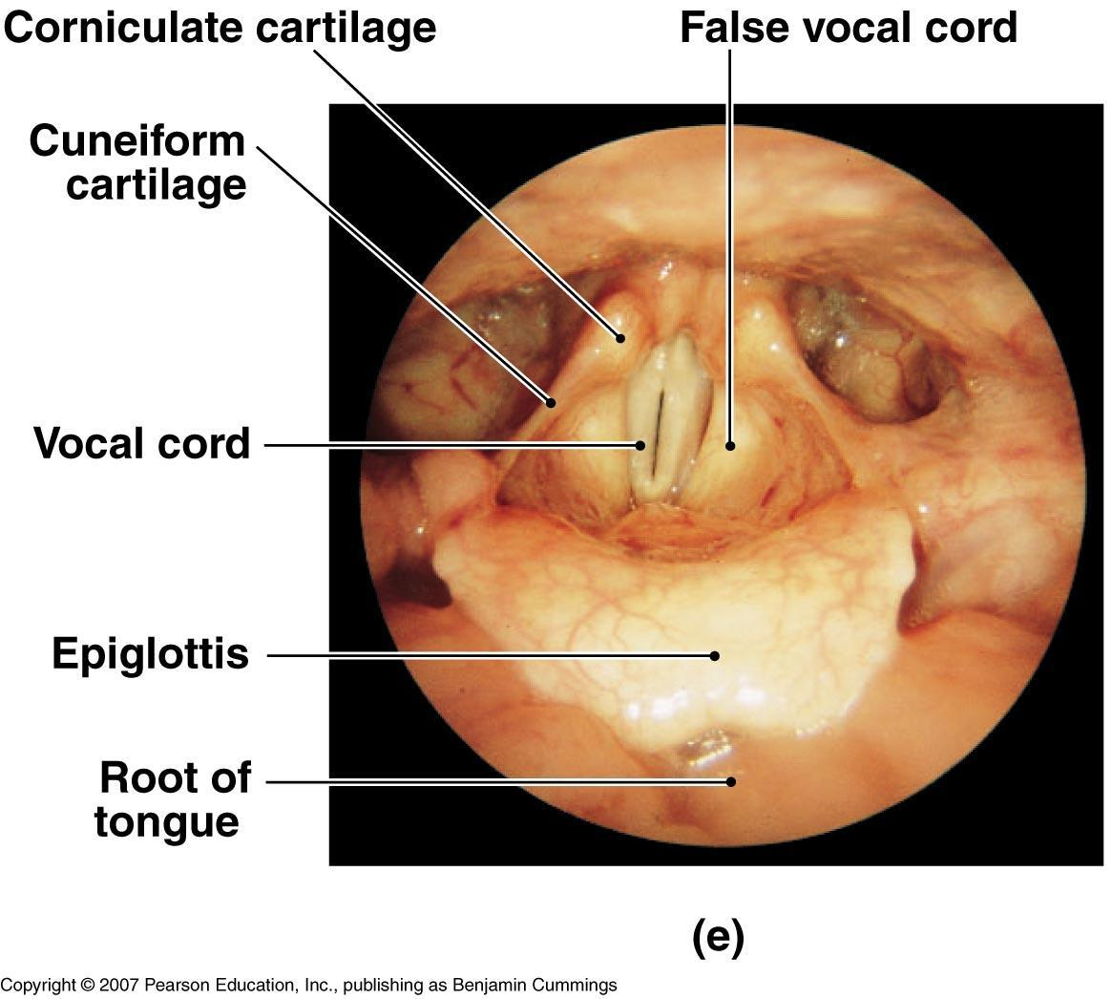
Respiratory System Organization
The Anatomy of the Larynx and Vocal Cords
Figure 15-4(e)
Notes:
11

Slide 12
Respiratory System Organization
#8: The Trachea
Also called “windpipe”
Stiffened by C-shaped cartilage rings
Rings prevent trachea from collapsing
Notes:
12

Slide 13
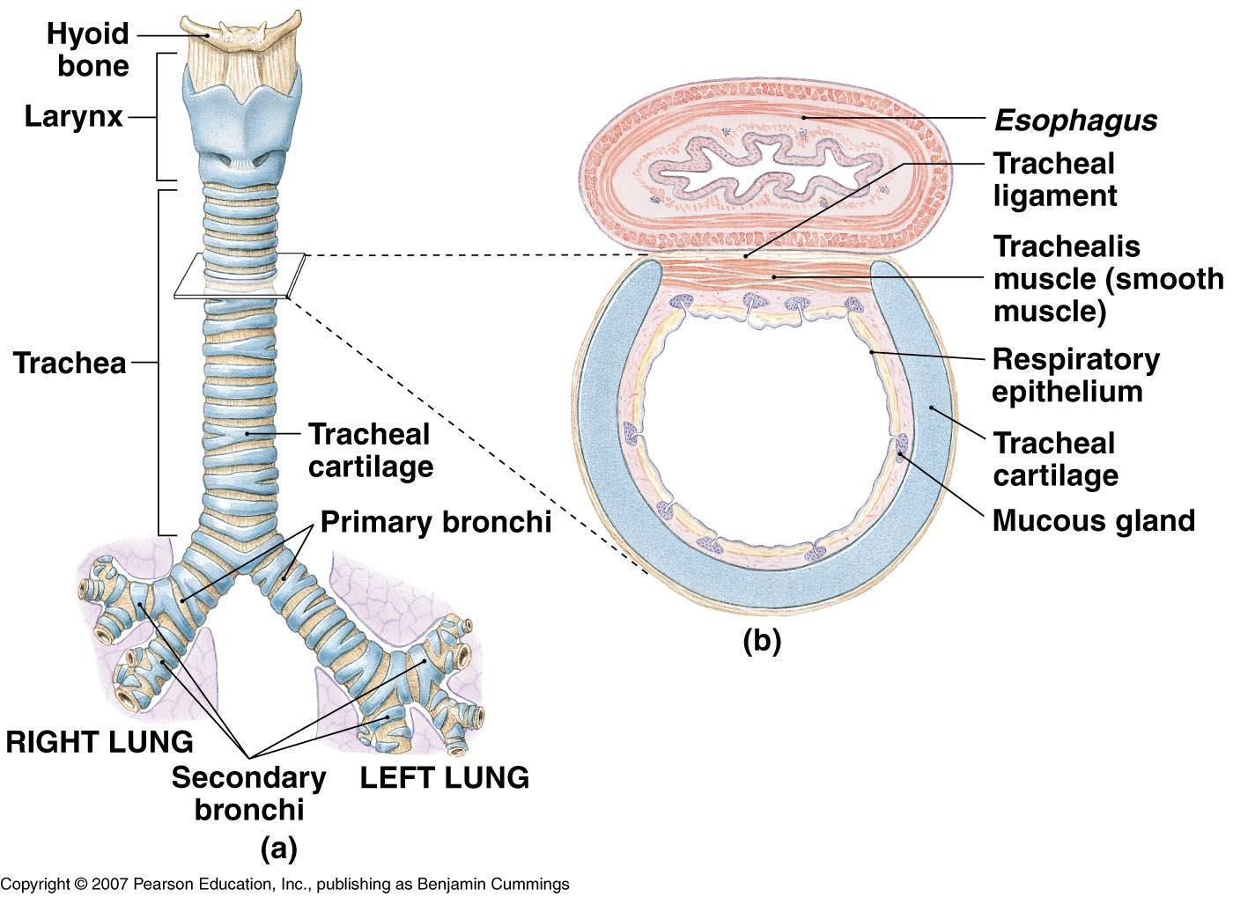
Respiratory System Organization
The Anatomy of the Trachea
Notes:
13

Slide 14
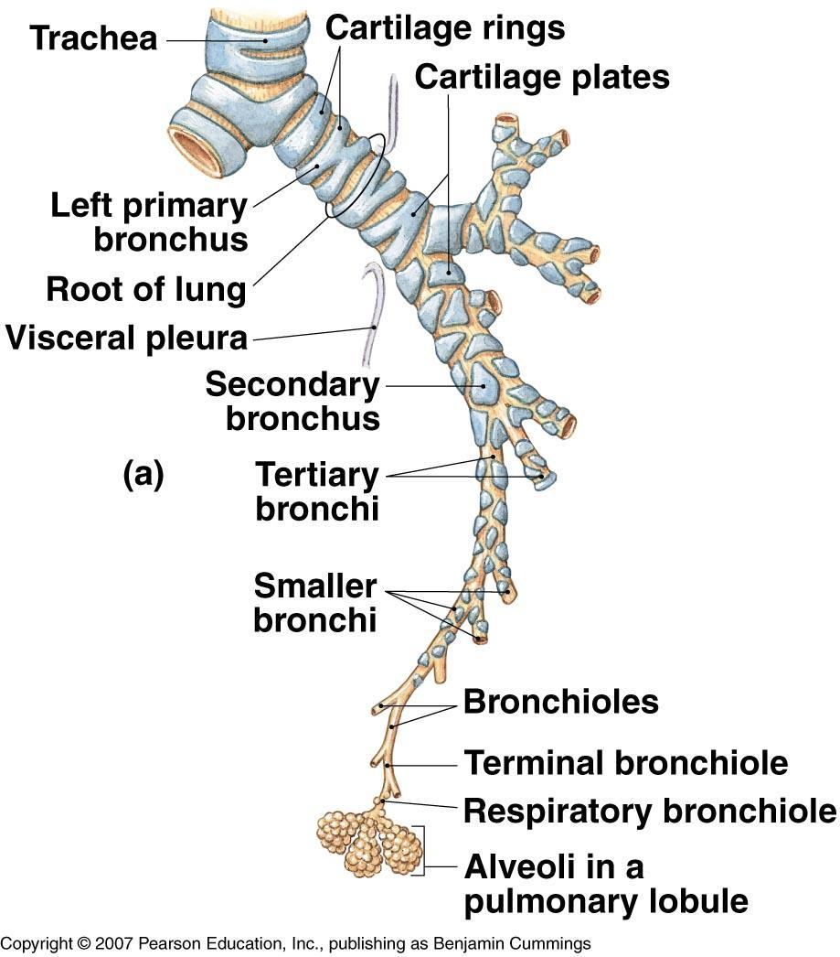
Respiratory System Organization
The Bronchial Tree
Figure 15-6(a)
Notes:
14

Slide 15
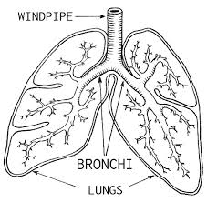
Respiratory System Organization
#5 (right) & #9 (left): The Bronchi (Bronchus)
First branches leading towards lungs
Branch smaller and smaller like a tree and lead into the bronchioles
Notes:
15

Slide 16
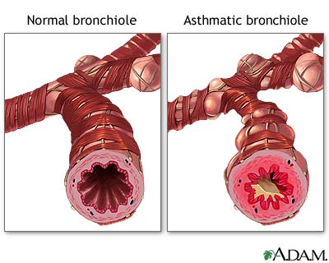
Respiratory System Organization
#10: The Bronchioles
Bronchioles lead into alveoli
controlled by Nervous System
Excess bronchoconstriction is asthma
Notes:
16

Slide 17
Respiratory System Organization
#11: The Alveoli
Oxygen and carbon dioxide exchange regions of lung
Air sacs at the end of the respiratory pathway
About 150 million/lung
Copyright © 2007 Pearson Education, Inc., publishing as Benjamin Cummings
Notes:
17

Slide 18
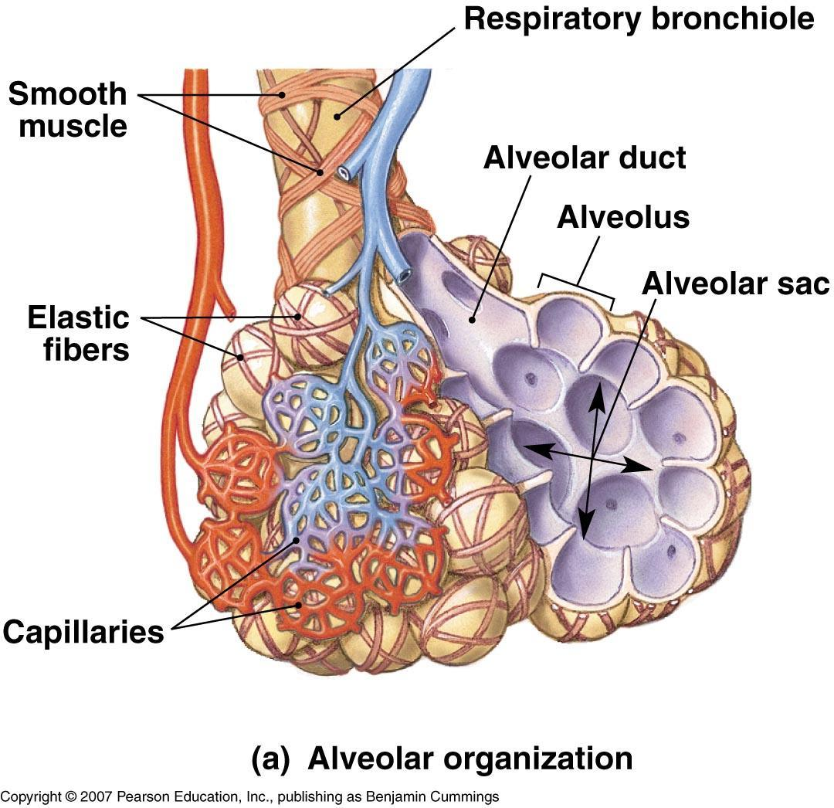
Respiratory System Organization
Alveolar Organization
Figure 15-7(a)
Notes:
18

Slide 19
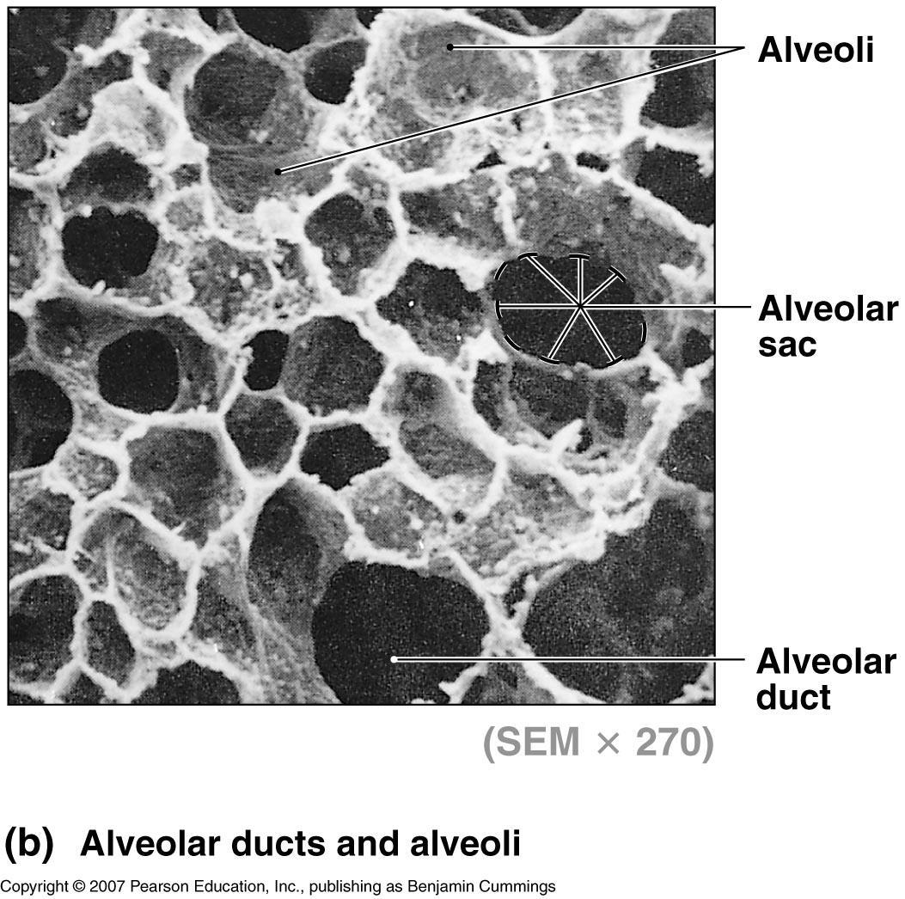
Respiratory System Organization
Alveolar Organization
Figure 15-7(b)
Notes:
19

Slide 20
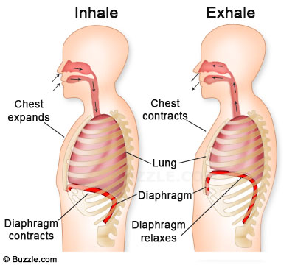
Respiratory System Organization
#6: The Diaphragm
Muscle below lungs that controls breathing
Notes:
20

Slide 21
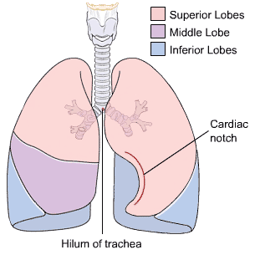
Respiratory System Organization
#4: The Lungs
Lungs have five lobes
three lobes on right, two on left
Heart is on the left (cardiac notch)
Apex (top) extends above first rib
Base (bottom) rests on diaphragm
Notes:
21

Slide 22
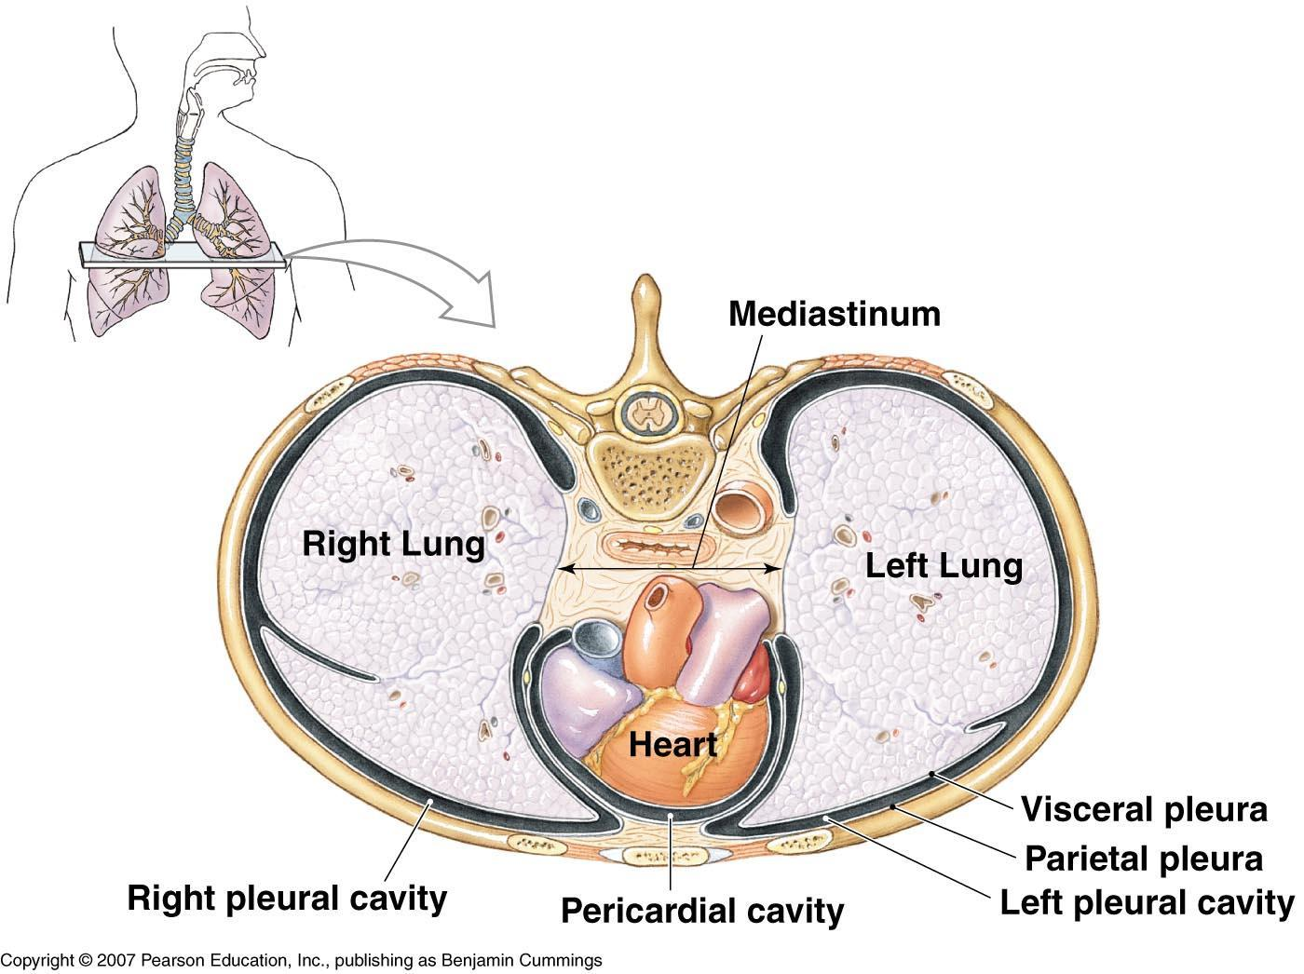
Respiratory System Organization
Anatomical Relationships in the Thoracic Cavity
Figure 15-9
Notes:
22

Slide 23
Respiratory Physiology
Pulmonary Ventilation
Respiratory cycle - A single breath consisting of inhalation and exhalation
Respiratory rate - Number of cycles per minute
Adult normal rate 12 to 18 breaths/minute
Child normal rate 18 to 20 breaths/minute
Copyright © 2007 Pearson Education, Inc., publishing as Benjamin Cummings
Notes:
23

Slide 24
Respiratory Physiology
Quiet versus Forced Breathing
Quiet breathing - Diaphragm and muscles between ribs are involved. Breathing is passive.
Forced breathing - Accessory muscles become active during the entire breathing cycle. Breathing is active.
Notes:
24

Slide 25
Respiratory Physiology
Capacities and Volumes
Tidal Volume
Amount of air moved in and out of lungs during normal breathing
Vital capacity
Maximum volume of air that can be moved in and out of the lungs
Residual volume
Volume of air remaining in the lung after a forced expiration
Notes:
25

Slide 26
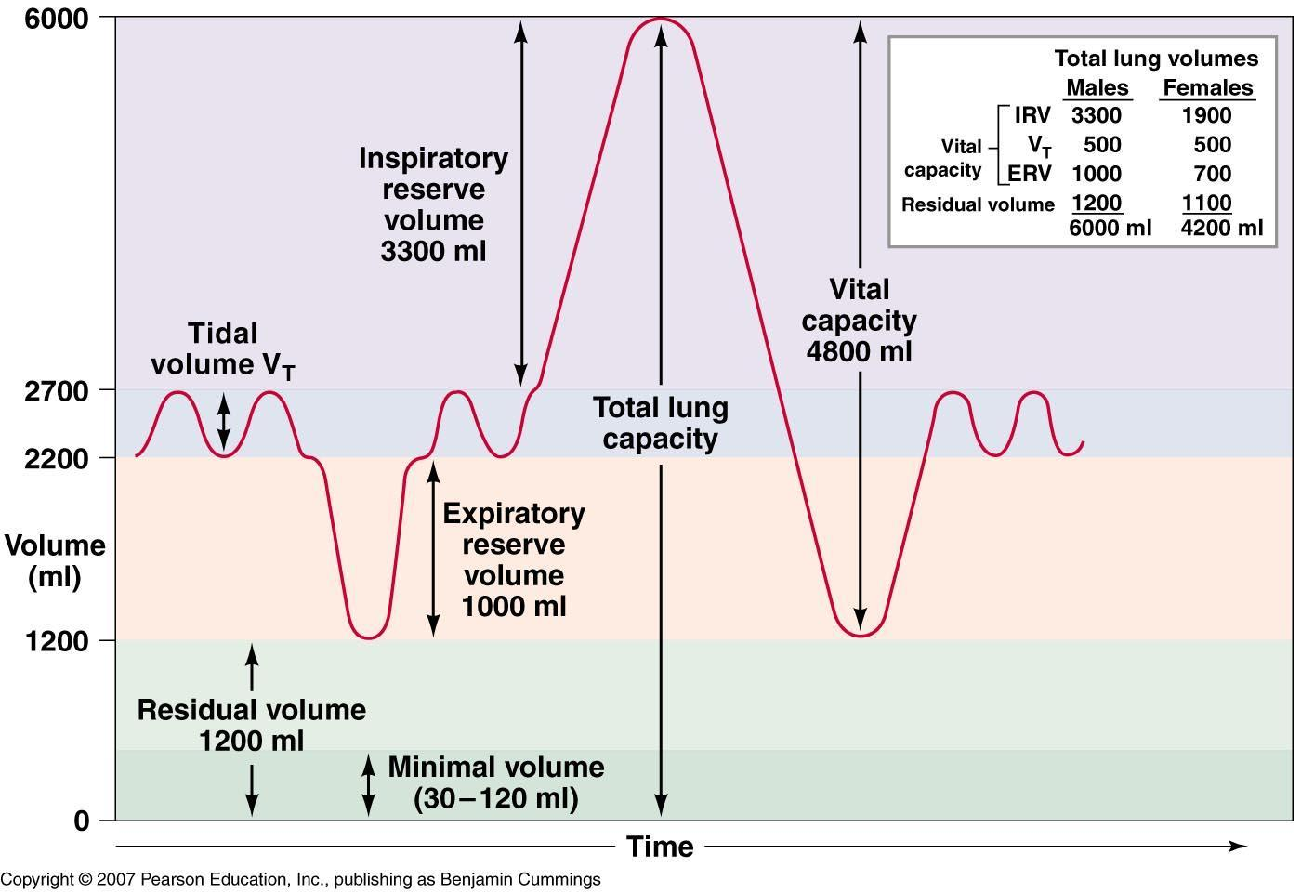
Respiratory Physiology
Respiratory Volumes and Capacities
Figure 15-11
Notes:
26

