Slide 1
POPULATION ECOLOGY
Characteristics of a Population

Slide 2
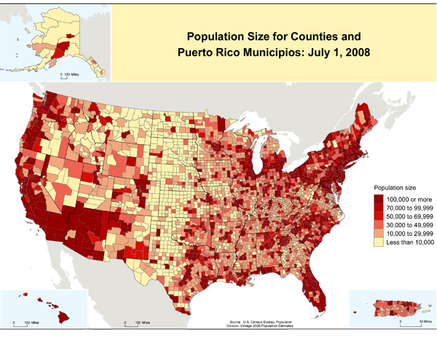
Size (N)
The amount of individuals in a population
Small, mid-size, large

Slide 3
Density
population size / total land or water area
Low density can lead to extinction

Slide 4
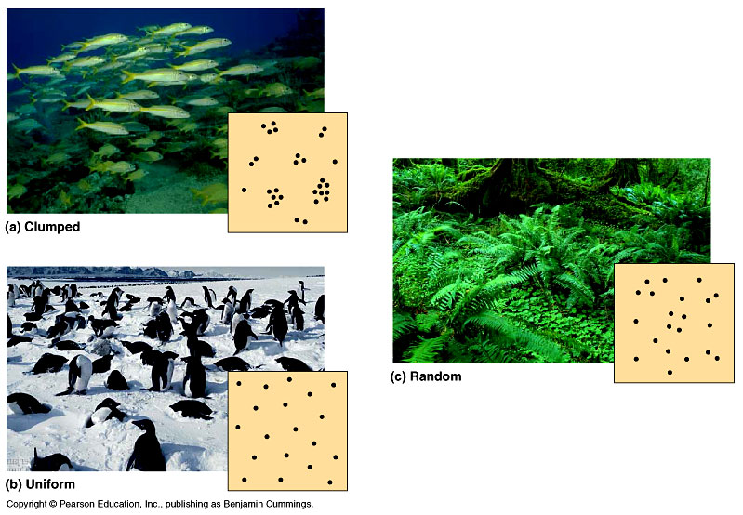
Dispersion
Observation of where individuals are found in a habitat.
How individuals “disperse” themselves

Slide 5
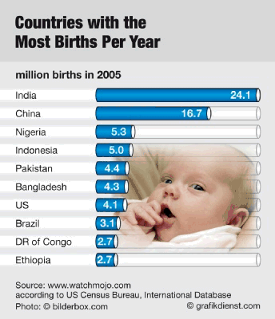
Birth Rate
Amount of births in a given amount of time in the population

Slide 6
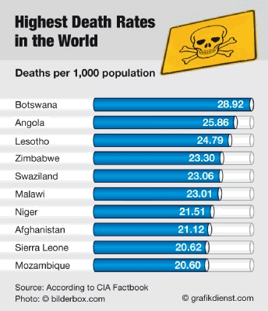
Death Rate
Amount of deaths in a given amount time in the population

Slide 7
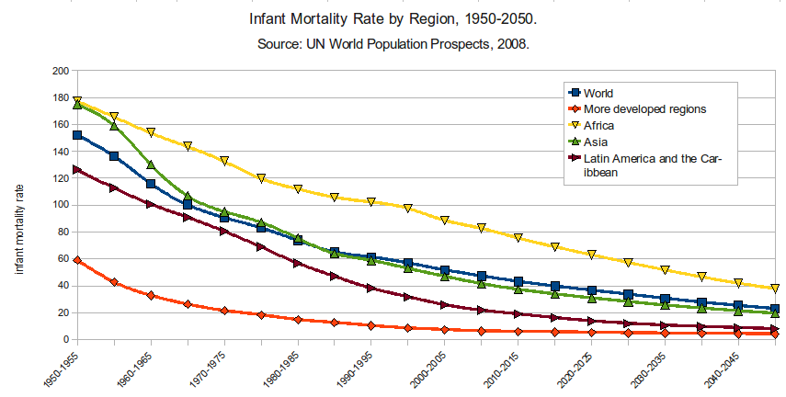
Mortality Rate
the number of deaths in a given area or period from a particular cause.

Slide 8
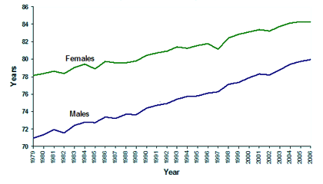
Life Expectancy
The expected number of years of life remaining at a given age.

Slide 9
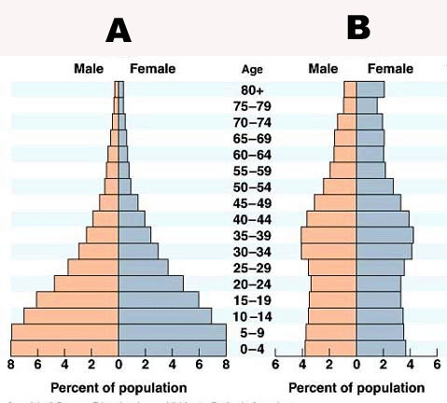
Age Structure
The distribution of individuals amongst various ages

Slide 10
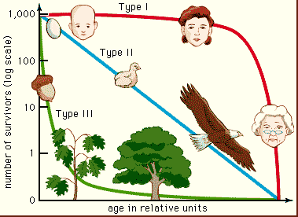
Survivorship Curves
A graph showing the number of individuals surviving at each age

Slide 11
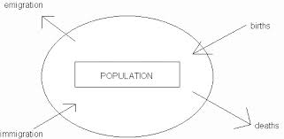
Growth Rates

Slide 12
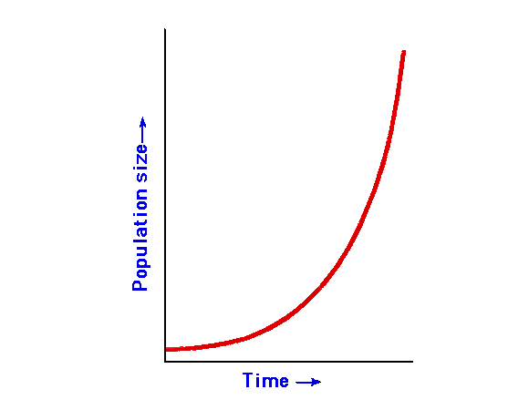
Exponential Model
Describes a population that increase rapidly after only a few generations.
The larger the population gets, the faster it grows.
J-shaped curve

Slide 13
Growth Limitations
Limiting factor – a factor that restrains the growth of a population
Competition increases as population increases
Density-Independent Factors – reduce the population by the same proportion regardless of population size. (weather, floods and fires)
Density-Dependent Factors – reduce the population by an amount proportional to the population size. (shortage of food, shortage of nesting sites and disease)

Slide 14
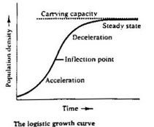
Logistic Model
Builds on the exponential model but accounts for the influence of limiting factors.
S –shaped curve
Carrying Capacity (K) – the number of individuals the environment can support over a long period of time.

Slide 15
Immigration/Emigration
Immigration – Individuals entering a population
Emigration – Individuals exiting a population

