Slide 1
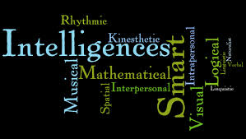
Multiple Intelligence
What kind of learner are you???

Slide 2
Multiple Intelligence
Musical
Kenesthetic
Interpersonal
Verbal
Logic Smart
Nature Smart
Intrapersonal
Visual

Slide 3
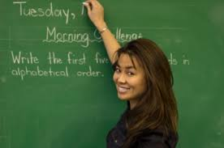
Visual Learner
Uses visual objects such as graphs, charts, pictures, and seeing information
Can read body language well
Able to memorize and recall various information
Tends to remember things that are written down
Learns better in lectures by watching them
Things that may help:
Turn notes into pictures, charts, or maps
Avoid distractions (windows, doorways, etc.)
Make mind and concept maps instead of outlines (Graphic Organizers)
Color code parts of new concepts in your notes
Use different colored pens/highlighters/pencils to take notes
Use flash cards when trying to study vocabulary

Slide 4
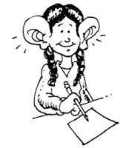
Auditory/Verbal Learner
Retains information through hearing and speaking
Often prefers to be told how to do things and then summarizes the main points out loud to help with memorization
Often has talents in music and may concentrate better with soft music playing in the background
Things that may help:
Record lectures and then listen to them
Repeat material out loud and in your own words
Discuss materials in your study groups
Read textbooks aloud
Listen to wordless background music while studying
Mnemonics
Dr. Seuss, with his talent for rhythm and meter and rhyme, was an auditory learner.

Slide 5
Kinesthetic Learner
• Likes to use the hands-on approach to learn new material
• Is generally good in math and science
• Would rather demonstrate how to do something rather than verbally explain it
• Usually prefers group work more than others.
Things that may help:
Take study breaks often
Learn new material while doing something active (e.g., read a textbook while on a treadmill)
Chew gum while studying
Work while standing
Try to take classes with instructors who encourage demonstrations and fieldwork

Slide 6
Naturalist Learner
Naturalistics learn by working with nature.
Naturalistic students enjoy learning about living things and natural events.
They may excel in the sciences and be very passionate about environmental issues.

Slide 7
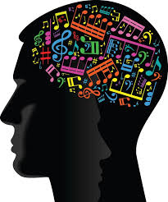
Musical
This can be connected to Auditory learning.
Listen to background music to block out other distracting sounds.

Slide 8
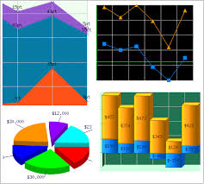
Logical
Learn best by
Classifying
Categorizing
Thinking abstractly about patterns, relationships, and numbers.

Slide 9
Intrerpersonal People Smart
Those who are people smart learn through
Relating to others by sharing
Comparing
Cooperating.
Interpersonal learners can make excellent group leaders and team players.

Slide 10
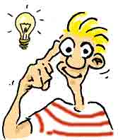
Intrapersonal Self Smart
Intrapersonal people learn best by
Working alone and setting individual goals.
Intrapersonal learners are not necessarily shy; they are independent and organized.

Slide 11
Now let’s try it out for ourselves and see what learners we are…
Multiple intelligence test….

