Slide 1
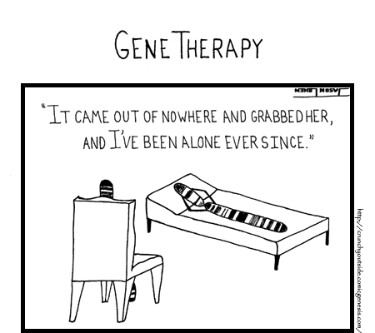
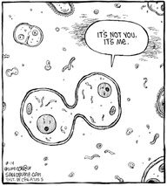
Meiosis

Slide 2
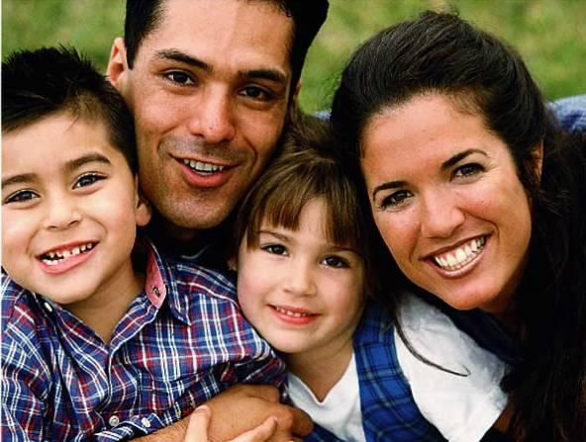
Meiosis – A Source of Distinction
Why do you share some but not all characters of each parent?
The answers lie in meiosis.

Slide 3
Formation of Gametes
Meiosis only occurs in the reproductive cells…all other cells undergo mitosis
Ending products of meiosis are haploid gametes
Eggs in female - oogenesis
Sperm in male - spermatogenesis
Fusion of sperm and egg results in a diploid cell

Slide 4
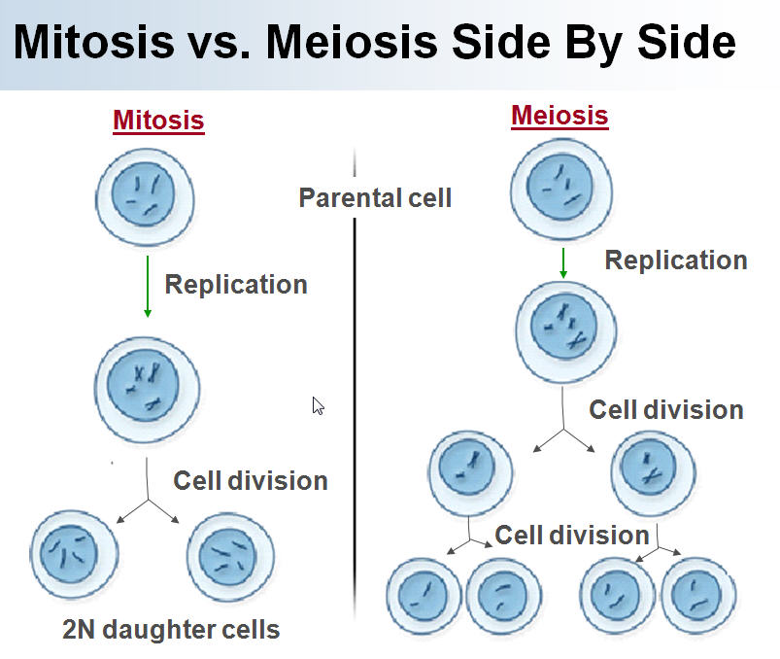

Slide 5
Meiosis does two things -
1) Meiosis takes a cell with two copies of every chromosome (diploid) and makes cells with a single copy of every chromosome (haploid).
This is a good idea if you’re going to combine two cells to make a new organism. This trick is accomplished by halving chromosome number.
In meiosis, one diploid cells produces four haploid cells.

Slide 6
2) Meiosis scrambles the specific forms of each gene that each sex cell (egg or sperm) receives.
This makes for a lot of genetic diversity. This trick is accomplished through independent assortment and crossing-over.
Genetic diversity is important for the evolution of populations and species.

Slide 8
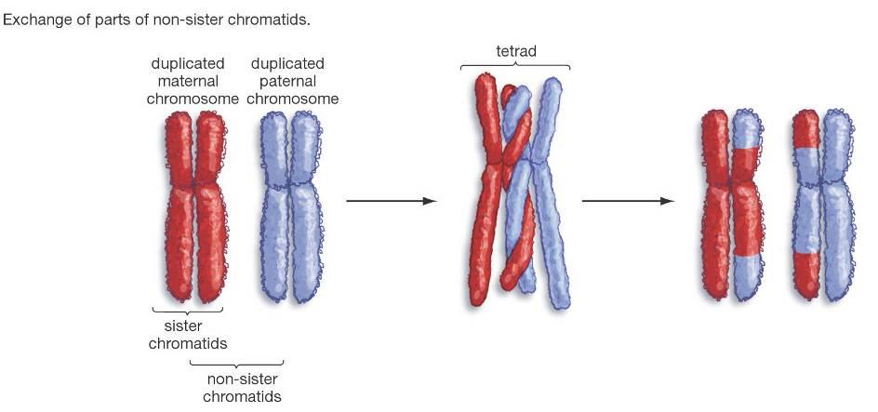
Another Way Meiosis Makes Lots of Different Sex Cells – Crossing-Over
Crossing-over multiplies the already huge number of different gamete types produced by independent assortment.

Slide 10
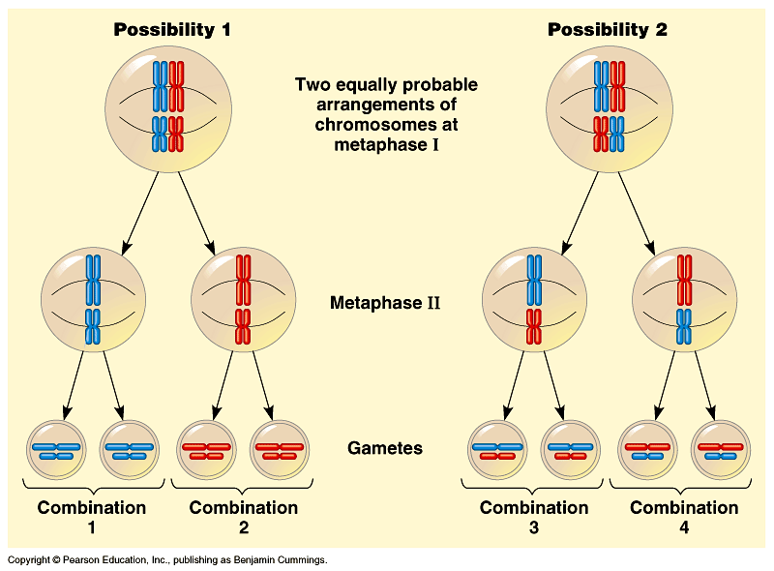

Slide 11
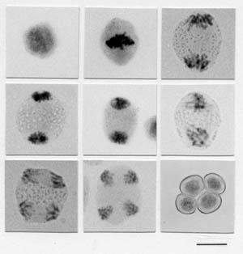
Meiosis – mouse testes
Parent cell
1st division
2nd division
4 gametes

Slide 12
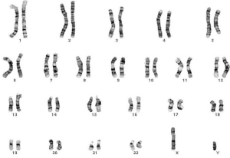
Karyotype
46 chromosomes, 23 pair
One of each pair was from mom, one from dad

Slide 13
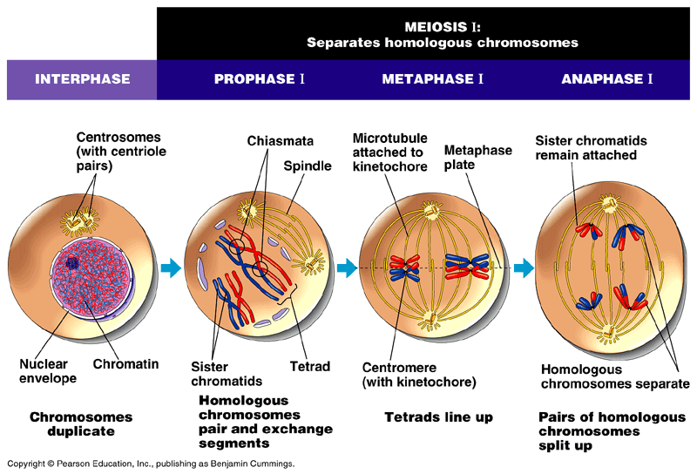
Figure 13.7 The stages of meiotic cell division: Meiosis I

Slide 14
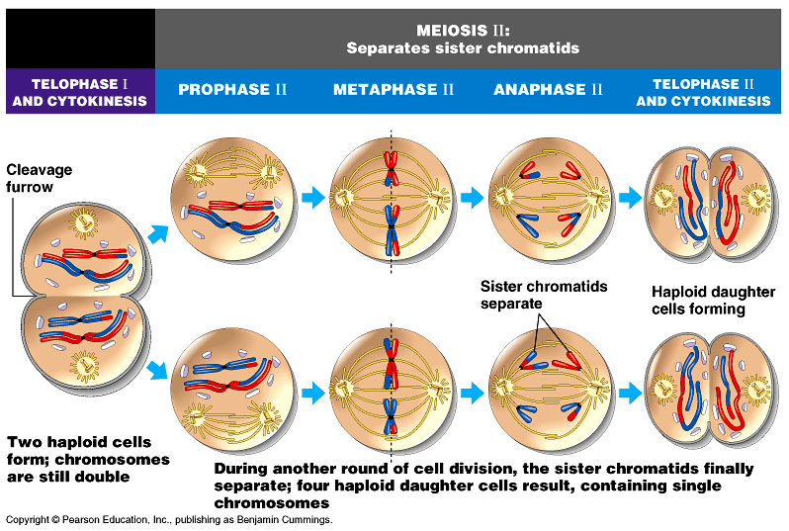
Figure 13.7 The stages of meiotic cell division: Meiosis II

