Slide 1
Genetic Traits

Slide 2
Dimples
Dimples
No Dimples

Slide 3
Rolled Tongue
Rolled Tongue
Can’t Roll Tongue

Slide 4
Hitchhiker’s Thumb
Hitchhiker’s Thumb
Regular Thumb

Slide 5
Earlobes
Free
Attached

Slide 6
Finger Spreading
Vulcan
Earthling

Slide 7
Cleft Chin
Cleft Chin
Regular Chin

Slide 8
Mid-Digital Hair
Hair
No Hair

Slide 9
Hair Type
Straight
Curly

Slide 10
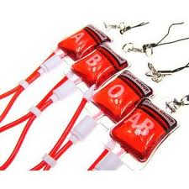
Blood Type

Slide 11
