Slide 1
Today’s Objectives
By the end of the period, you will be able to . . .
- Describe how organisms respond to their environment
- Design an organism uniquely adapted to the environment you selected

Slide 2
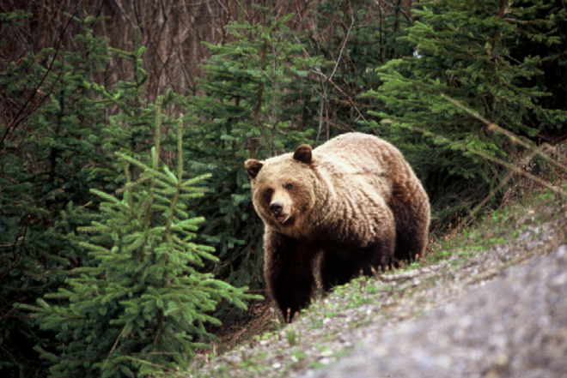
Environmental Factors
Biotic factors – living things in the environment that affect an organism. (plants and animals).
Abiotic factors – non-living things in the environment that affect an organism. The physical and chemical characteristic of the environment. (temperature, humidity, pH, salinity, amount of sunlight…).

Slide 3
The Changing Environment
Abiotic factors are not constant
They vary form place to place and over time
Temperature
http://geography.uoregon.edu/envchange/clim_animations/gifs/tmp2m_web.gif

Slide 4
Responding to a Changing Environment
Organisms adapt to function within a specific range of temperatures
Tolerance curve – measures how efficiently an organism performs at different values of an environmental variable (i.e. temperature)

Slide 5
Acclimation
The process through which some organisms can adjust their tolerance to abiotic factors.
Elevation acclimation
Reduced oxygen levels
Number of red blood cells increase to allow for more oxygen that your blood can carry
Acclimation vs. Adaptation
Acclimation occurs within organism’s lifetime
Adaptation is a genetic change in a species over many generations

Slide 6
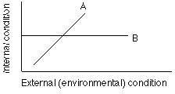
Control of Internal Conditions
Conformers – organisms that change as their external environment changes (desert lizards’ body temp rises and falls with the environment temp).
Regulators – organisms that use energy to control some of their internal conditions (humans maintain their internal body temp within a few degrees of 98.6°)

Slide 7
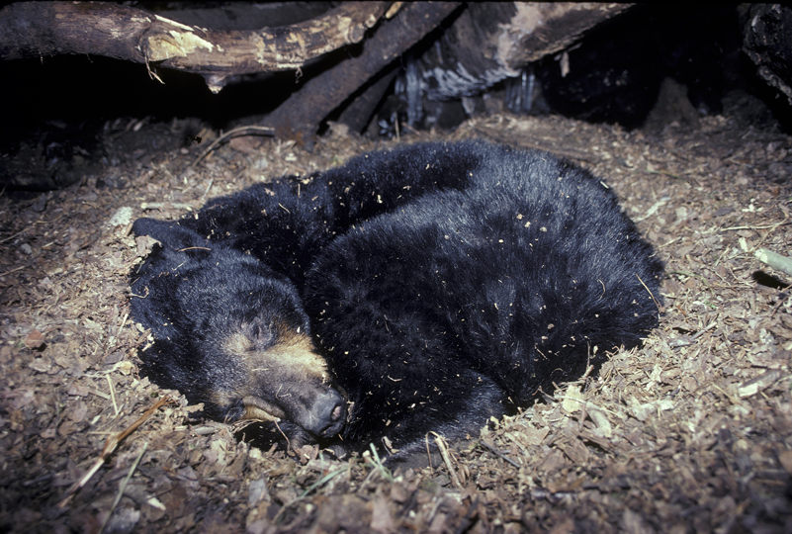
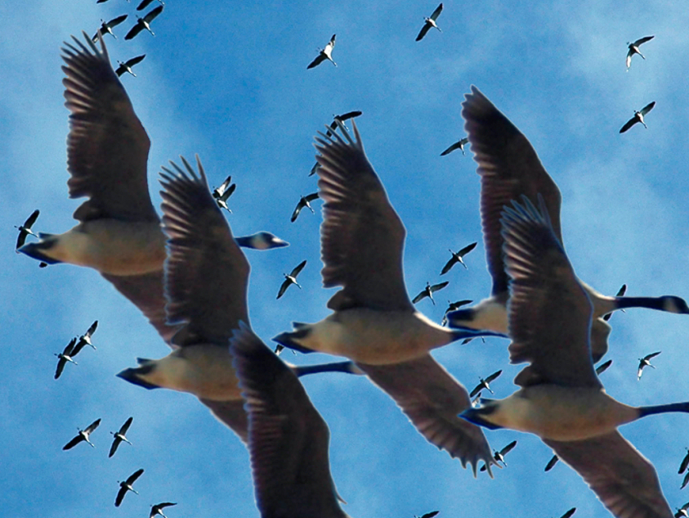
Escape from Unsuitable Conditions
Dormancy – organism enters a state of reduced activity during periods of unfavorable conditions (hibernation).
Migration – organism moves to a more favorable habitat (birds).

Slide 8
The Niche
The role a species plays in its environment, its way of life.
The niche includes:
Range of conditions it can tolerate
Methods by which it obtains resources
Number of offspring it has
Its time of reproduction
All other interactions with its environment

Slide 9
Niches
Fundamental Niche – range of conditions that a species can potentially tolerate and the resources it can potentially use.
Realized Niche – range of resources the species actually uses.
Generalists – species with a broad niche
Specialists – species with a narrow niche

