Slide 1
Intro to Ecology

Slide 2
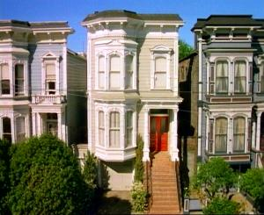
Ecology - Definition
The study of the interactions between organisms and the living and nonliving components of their environment.
Eco- is from the Greek
root “Oikos” meaning
“home” or “place to live”

Slide 3
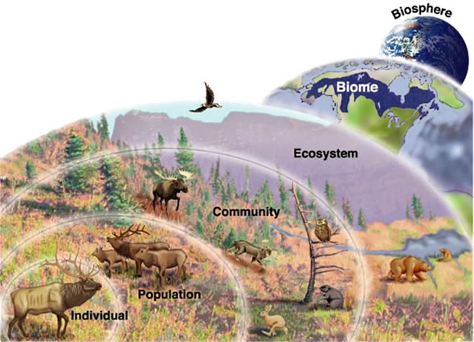
Levels of Organization

Slide 4
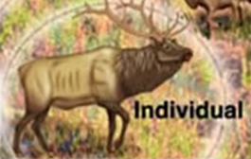
Organism
Simplest level of organization
Consists of 1 individual

Slide 5
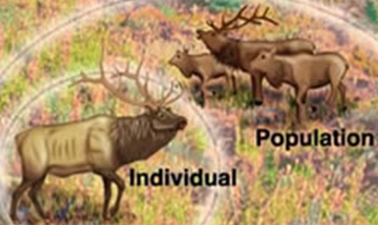
Population
Includes all the members of a species that live in one place.
Members are of one single species.
2 or more organisms.

Slide 6
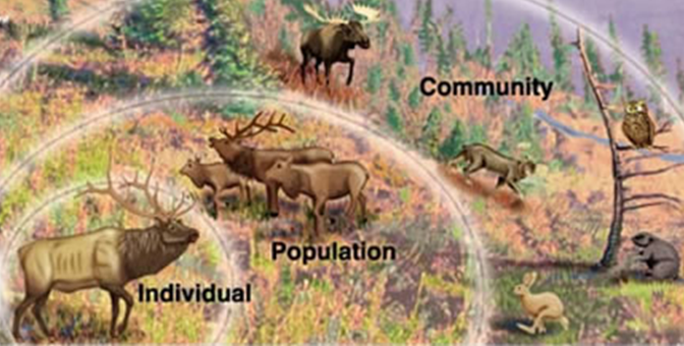
Community
Includes all of the interacting organisms living in an area.
Multiple different species.
Does not include non-living factors! Only LIVING!

Slide 7
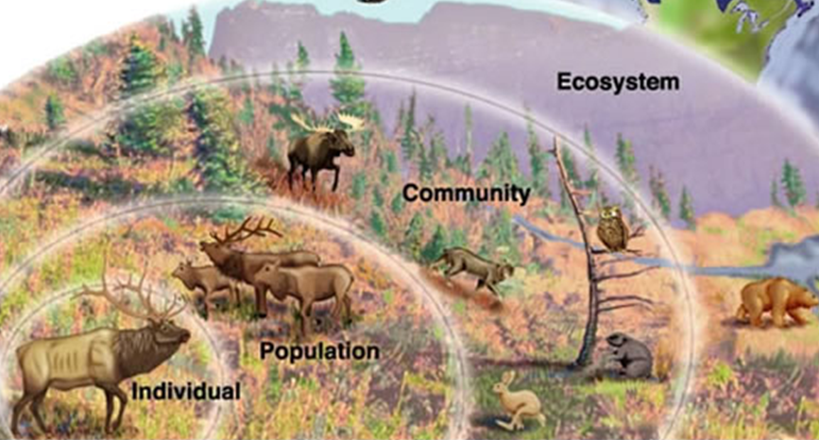
Ecosystem
Includes all living AND non-living factors in an area.
Non-living factors : physical (sunlight) and chemical (dissolved oxygen and ph of a lake)

Slide 8
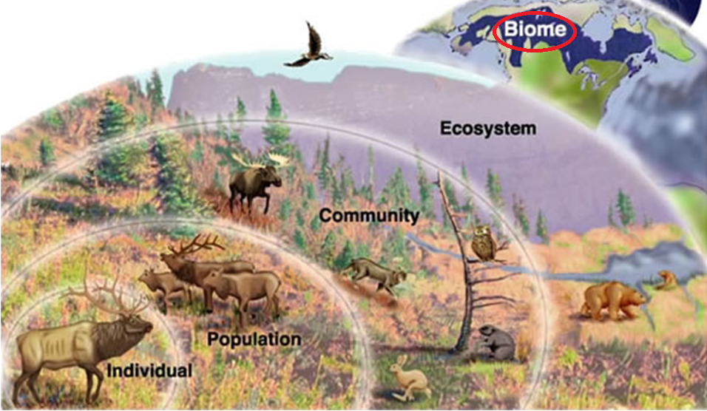
Biome
a major geographic region that contains a distinctive community of plants, animals, fungi, etc.
include grassland, tundra, desert, tropical rainforest, and deciduous and coniferous forests

Slide 9
Biosphere
Most inclusive level
Includes the thin volume of Earth and its atmosphere that supports life
Only about 13 miles thick (from 5 to 6 miles above the Earth’s surface to the deepest parts of the ocean.
Earth’s diameter is about 7,900 miles.

Slide 10
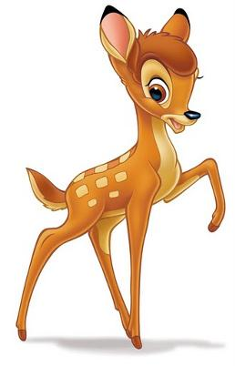
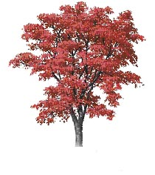
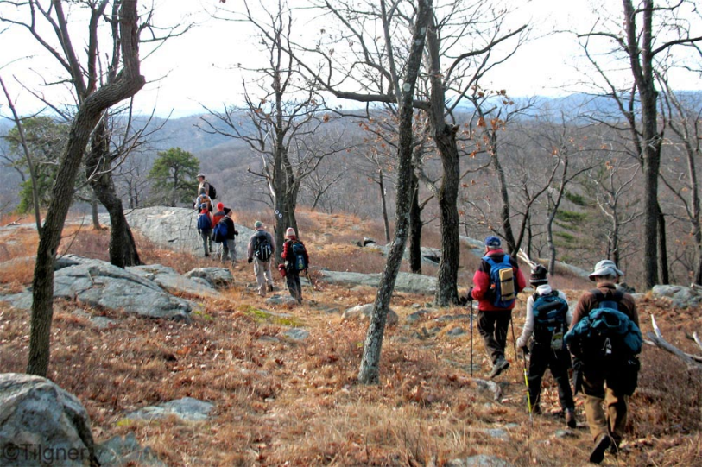
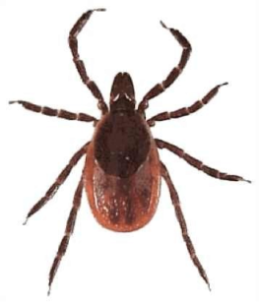
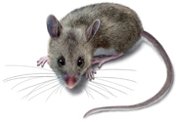
Interconnectedness
Lyme Disease

Slide 11
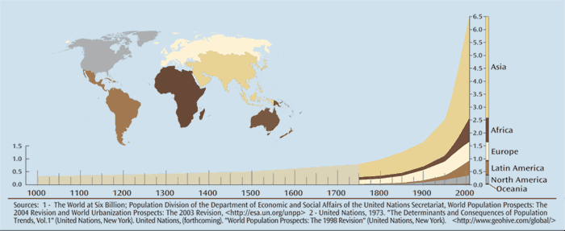
Human-Caused Environmental Problems
Pollution from non biodegradable waste.
Destroying natural land to make room for buildings and houses
Deforestation diminishes amount of breathable air.
Chemical waste disposal.
Humans are in exponential growth which will create a greater demand on all resources

