Slide 1
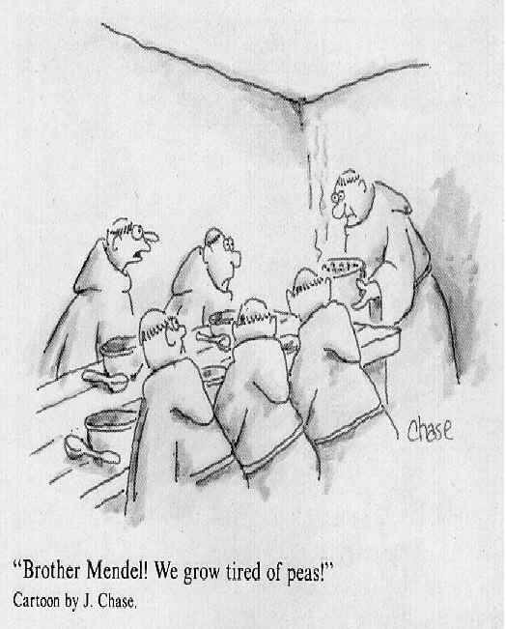
Classic Genetics a.k.a. Mendelian Genetics

Slide 2
Vocabulary
Genetics: The scientific study of heredity
Allele: Alternate forms of a gene.
Genotype: combination of alleles an organism has.
Phenotype: How an organism appears.
Dominant: An allele which is expressed (masks the other).
Recessive: An allele which is present but remains unexpressed (masked). (unless combined with another recessive allele).
Homozygous: Both alleles for a trait are the same.
Heterozygous: The organism's alleles for a trait are different.

Slide 3
Mendel and His Peas
Principles of genetics were developed in the mid 19th century by Gregor Mendel an Austrian Monk
Experimented with pea plants, by crossing various strains and observing the characteristics of their offspring.

Slide 4
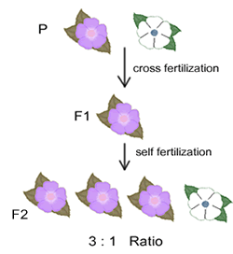
Generations
P – Parental Generation
F₁ – 1st Filial Generation
F₂ – 2nd Filial Generation
Filial = son or daughter

Slide 5
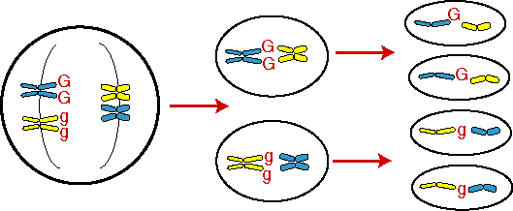
Law of Segregation
When gametes (sperm & egg) are formed each gamete will receive one allele or the other.

Slide 6
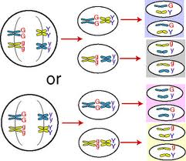
Law of Independent Assortment
Two or more alleles will separate independently of each other when gametes are formed (not all people with blue eyes also have brown hair)

Slide 7
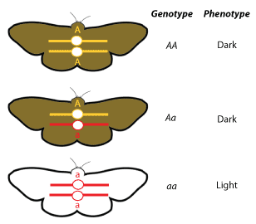
Molecular Genetics
Study of the structure and function of chromosomes and genes.
Genotype vs. Phenotype

Slide 8
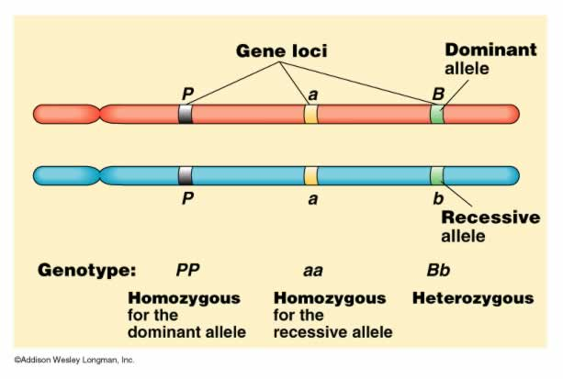
Homozygous vs. Heterozygous
HOMOzygous Dominant= AA
HOMOzygous Recessive = aa
HETEROzygous = Aa

Slide 9
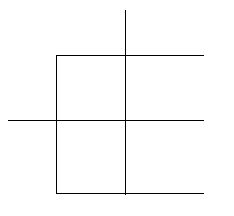
Predicting Results of Breeding
Genetic problems can be easily solved using a tool called a punnett square.
Tool for calculating genetic probabilities

Slide 10
Monohybrid Cross (cross with only 1 trait)
Problem:
Using this is a several step process, look at the following example
Tallness (T) is dominant over shortness (t) in pea plants. A Homozygous tall plant (TT) is crossed with a short plant (tt). What is the genotypic makeup of the offspring? The phenotypic makeup ?

Slide 11
Punnett Process
Determine alleles of each parent, these are given as TT, and tt respectively.
Take each possible allele of each parent, separate them, and place each allele either along the top, or along the side of the punnett square.

Slide 12
Punnett Process
Lastly, write the letter for each allele across each column or down each row. The resultant mix is the genotype for the offspring.

Slide 13
Punnett Process
Lets take this a step further and cross these F1 offspring (Tt) to see what genotypes and phenotypes we get.
Since each parent can contribute a T and a t to the offspring, the punnett square should look like this….

Slide 14
Dihybrid Cross (Cross with 2 traits)

Slide 15
Genotypic Ratio
1 TT: 2 Tt: 1 tt
1:2:1

Slide 16
Phenotypic Ratio
3 Tall: 1 Short

Slide 17
Incomplete Dominance

Slide 18
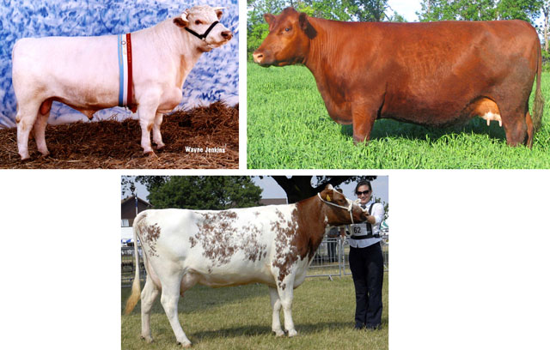
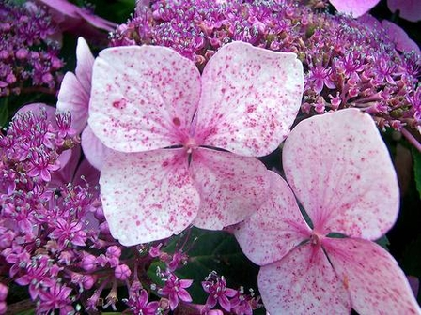
Codominance
Neither allele is dominant or recessive

