Slide 1
Chemical Reactions: Reaction Energy, Water & Macromolecules

Slide 2
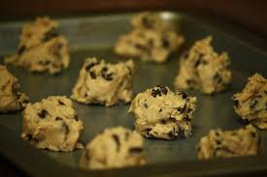
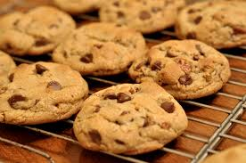
Chemical reactions need ENERGY
Most compounds need energy to go through chemical reactions
Heat = Energy

Slide 3
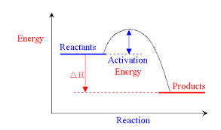
Activation Energy
Minimum amount of energy needed for reactants to form products in a chemical reaction

Slide 4
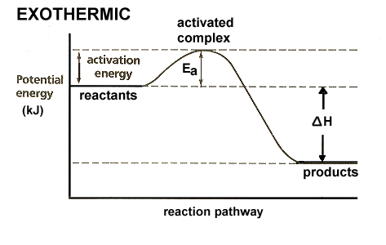
Exothermic
Energy is released (Gives off heat)
Product energy is lower than reactant energy

Slide 5
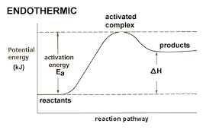
Endothermic
Energy is absorbed (cooling effect)
Product energy is higher than reactant energy

Slide 6
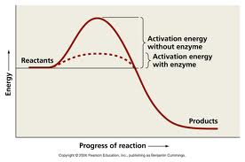
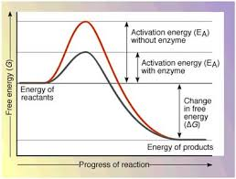
Enzymes/Catalysts
Catalyst – substance that lowers activation energy
Enzyme – protein that lowers activation energy

Slide 7
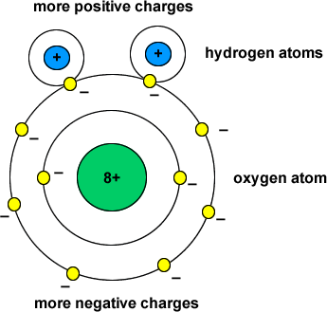
Water
H₂O
Covalent bonds
Electrons spend more time around oxygen molecule
Polar molecule – charges are uneven throughout the molecule

Slide 8
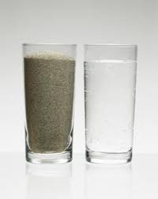
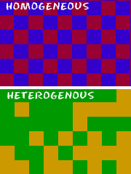
Mixtures with water
Homogenous – same throughout (solution)
Heterogeneous – different throughout (suspension)

Slide 9
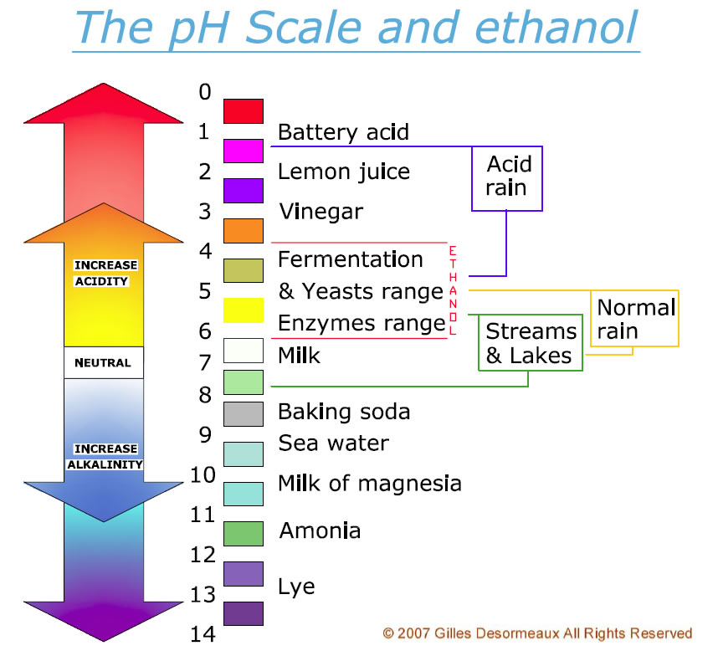
Acids vs. Bases
Acids – release hydrogen ions (H⁺) when dissolved in water
Bases – release hydroxide ions (OH ⁻) when dissolved in water
pH = parts hydrogen

Slide 10
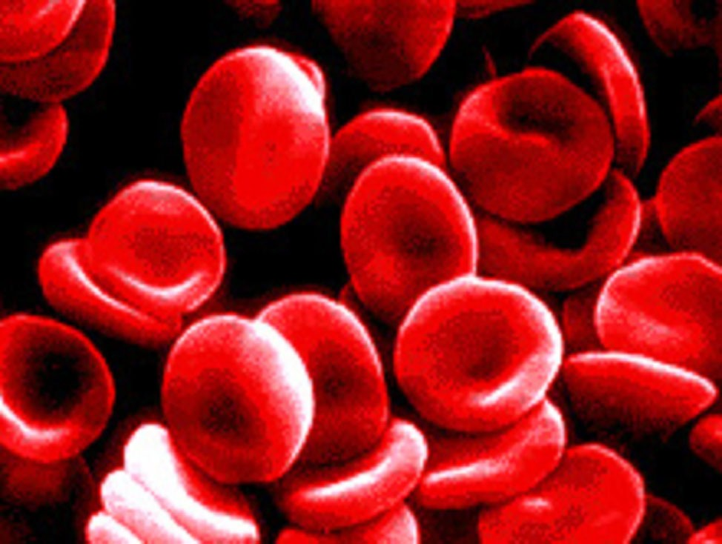
Buffers
Mixture that can react with acids or bases to keep the pH in a certain range
Blood = 7.4

Slide 11
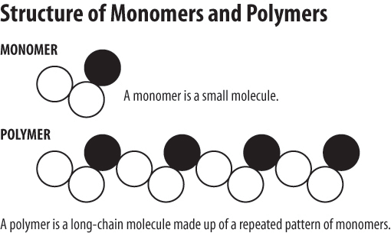
Macromolecules
Macromolecules - Large molecules formed by joining smaller molecules together
Polymers – repeating units of identical compounds called monomers

Slide 12
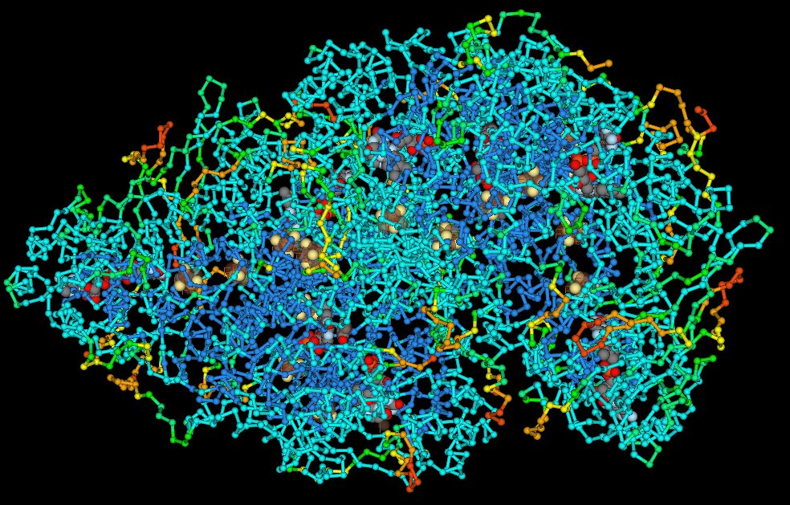
Macromolecules of Life

Slide 13
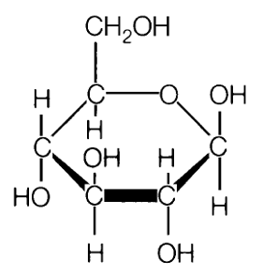
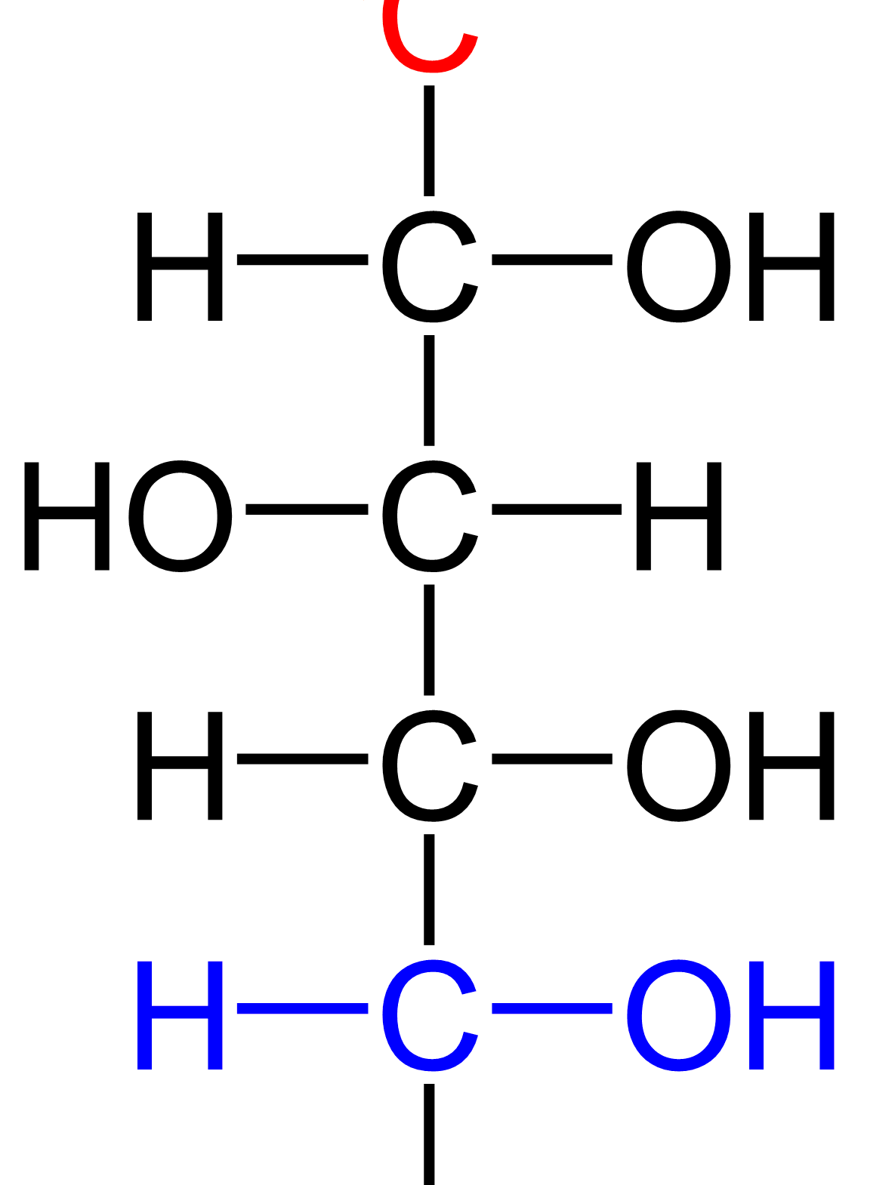
Carbohydrates
Sub-unit: sugar and starch
Composed of carbon, hydrogen and oxygen
Stores energy
Provides structural support
Examples: glucose, cellulose (plants), chitin (shellfish), bread/wheat

Slide 14
Lipids
Sub-unit: fatty acids & glycerol
Composed of mostly carbon and hydrogen
Stores energy
Provides barriers
Examples: fats, oils, waxes, triglycerides, plant leaves and beeswax

Slide 15
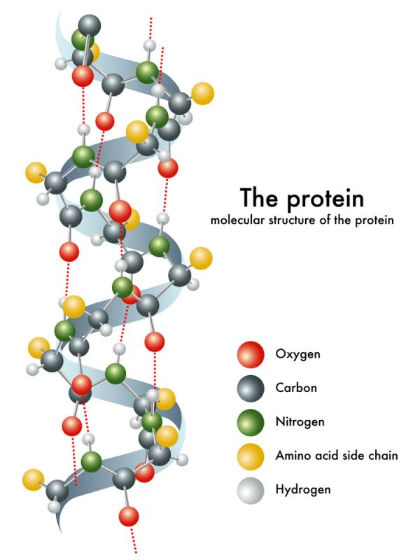
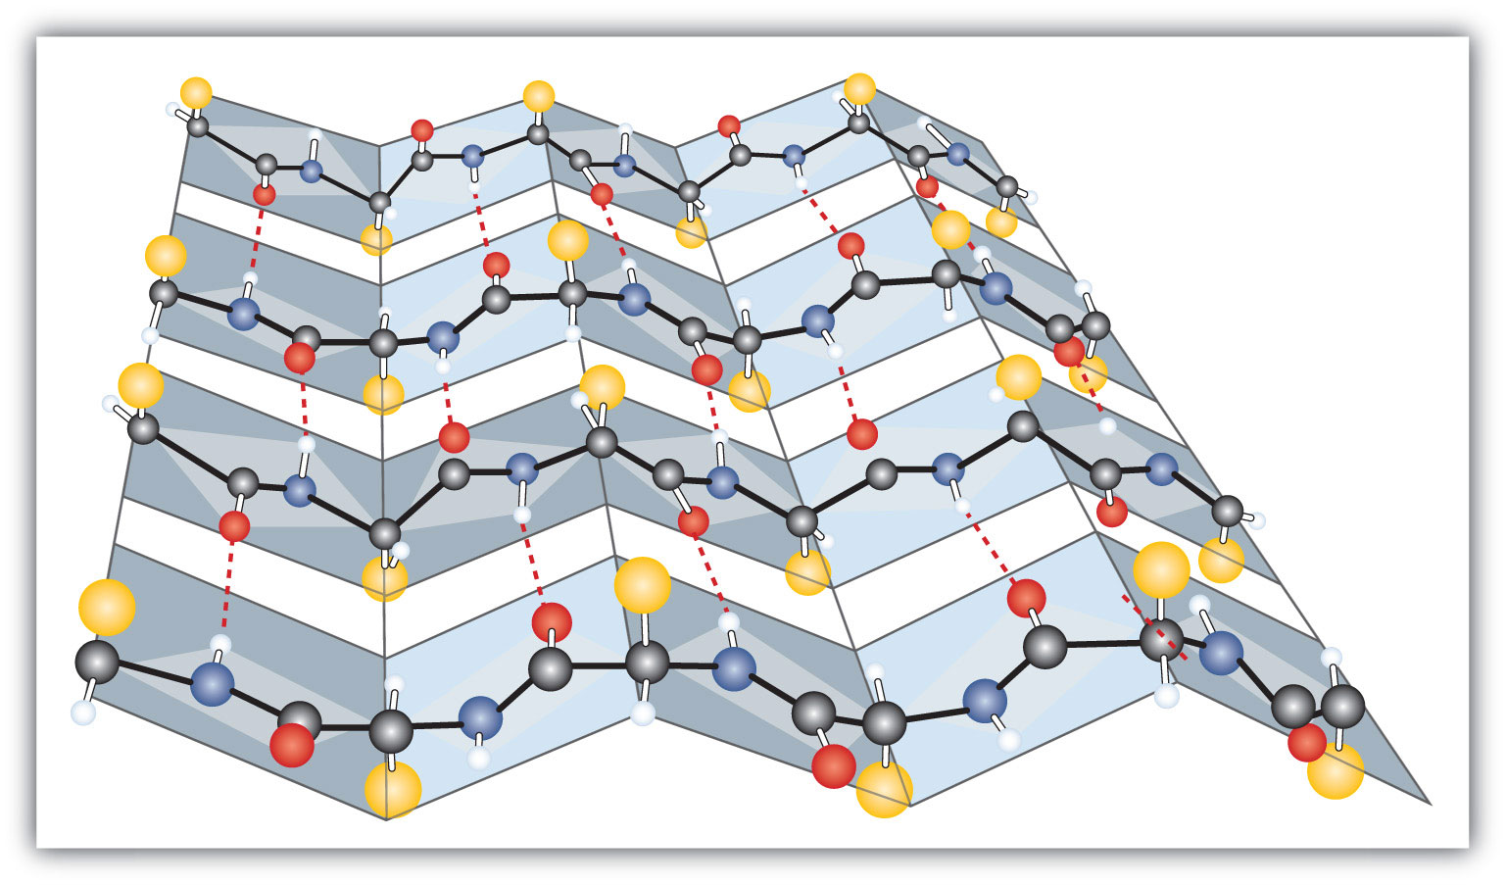
Proteins
Sub-unit: amino acids
Composed of carbon, hydrogen, nitrogen, oxygen and sometimes sulfur
Transport substances
Speeds reactions
Structural support
Makes hormones
Examples: muscle, skin and hair

Slide 16
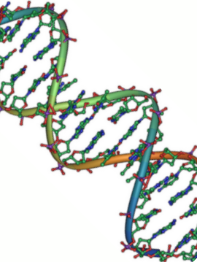
Nucleic Acids
Sub-unit: nucleotides
Composed of carbon, hydrogen, nitrogen, phosphorus and oxygen
Stores and communicates genetic information
Examples:DNA & RNA

Slide 17
Tomorrow's Lab!!!!!!! A Murder and a Meal

Slide 18
Safety
Goggles at all times
Wash hands before leaving
No eating!!!

Slide 19
Data table 1: Testing for Macromolecules
Macromolecule | Chemical test | Positive test result | Negative test result
Lipid | Paper Towel | Oil Ring | No Ring
Protein | Biuret | Violet, black | Blue
Starch | Iodine | Black | Dark red
Sugar | Benedict's | Orange | Blue

