Slide 1
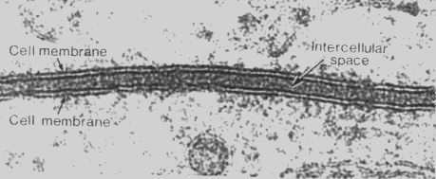
Cellular Transport

Slide 2
Cell Membrane Review
All cells have a cell membrane
Functions:
Controls what enters and exits the cell to maintain an internal balance called homeostasis
Provides protection and support for the cell

Slide 3
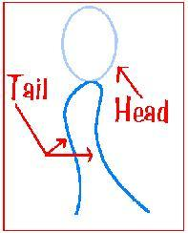
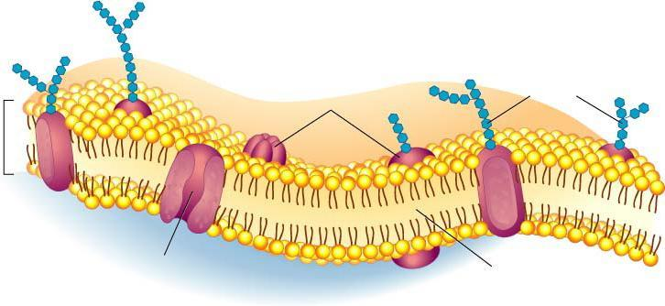
Membrane Structure Review
Lipid Bilayer -2 layers of phospholipids
Phosphate head is hydrophillic (water loving)
Fatty acid tails hydrophobic (water fearing)

Slide 4
Types of Cellular Transport
Passive
Active
Diffusion
Facilitated Diffusion
Osmosis
cell DOESN’T use energy
Protein Pumps
Endocytosis
Exocytosis
Cell DOES use energy
Weeee!!!
This is gonna be hard work!!
high
high
low
low

Slide 5
Passive Transport
cell uses no energy
molecules move randomly
Molecules spread out from an area of high concentration to an area of low concentration.
(High→Low)

Slide 6
Active Transport
cell uses energy
actively moves molecules to where they are needed
Movement from an area of low concentration to an area of high concentration
(Low → High)

Slide 7
Passive Transport: 1. Diffusion
Random movement of particles from an area of high concentration to an area of low concentration.

Slide 8
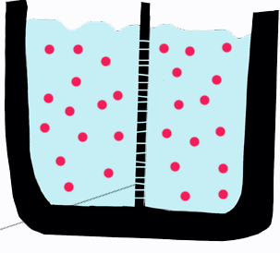

Slide 9
Passive Transport: 2. Facilitated Diffusion
Cellular Transport from HIGH concentration to LOW concentration through a transport PROTEIN!

Slide 10
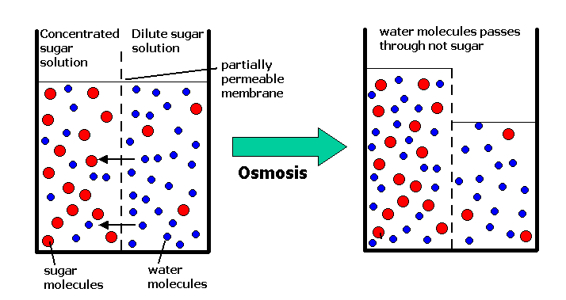
Passive Transport: 3. Osmosis
diffusion of water through a selectively permeable membrane
Water moves from high to low concentrations

Slide 11
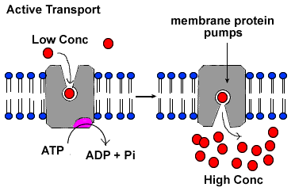
Active Transport: 1. Protein Pumps
Transport proteins that require energy to do work
Protein changes shape to move molecules: this requires energy!

Slide 12
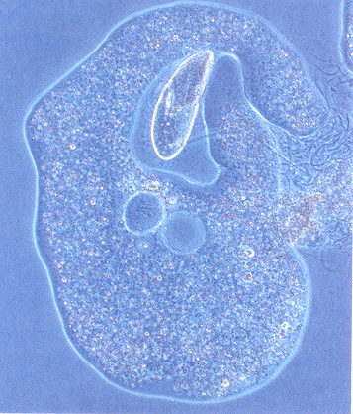
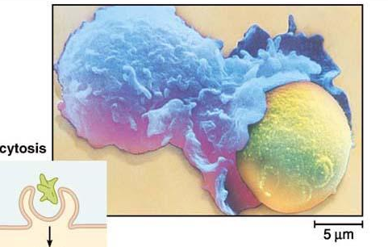
Active Transport: 2. Endocytosis
Taking bulky material into a cell
Cell membrane in-folds around food particle
“cell eating”

Slide 13
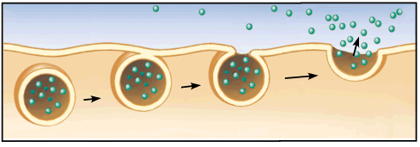
Active Transport: 3. Exocytosis
Endocytosis & Exocytosis animations
Forces material out of cell in bulk
membrane surrounding the material fuses with cell membrane

