Slide 1
Cell theory
Chapter 7.1

Slide 2
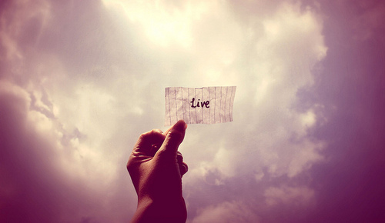
Living things are different from non-living things
How would you define something as living?

Slide 3
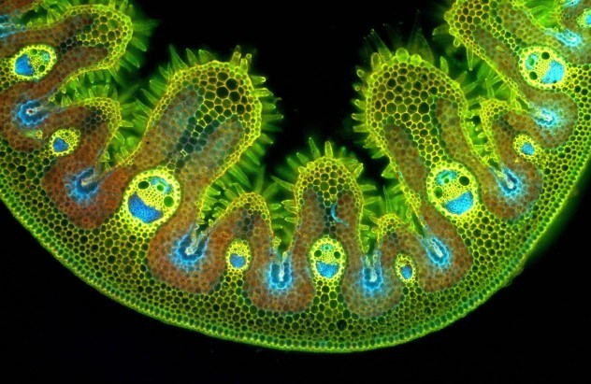
Organism (living thing)
Any individual form of life that uses energy to carry out its activities.

Slide 4
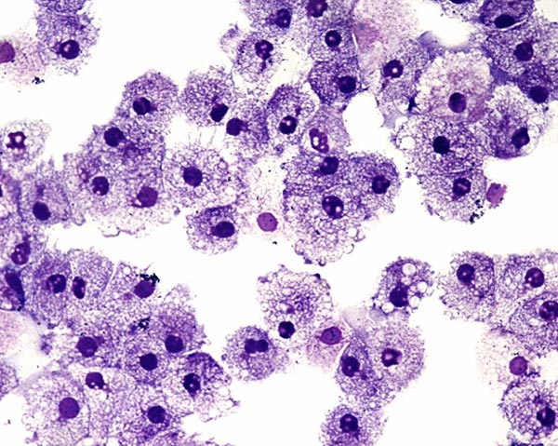
All living things:
are made up of cells (organization).
respond to the environment.
have the ability to reproduce.
move.
grow and develop.
perform metabolic processes. (Metabolism- the sum of the physical and chemical processes in an organism)

Slide 5
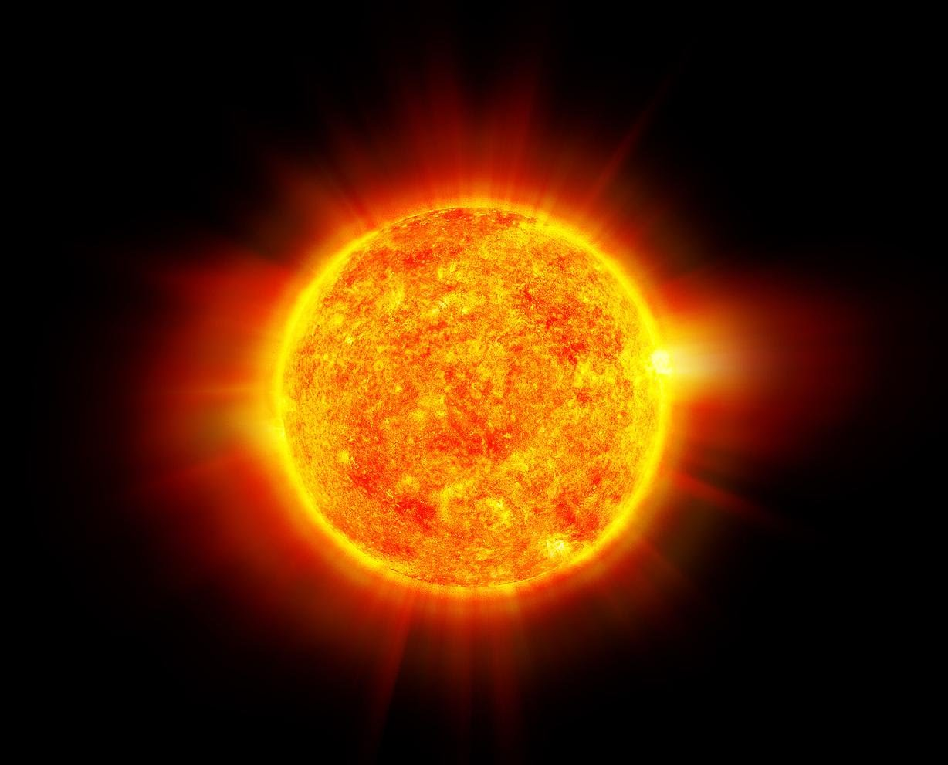
Needs for life:
Organisms need energy, materials, and living space.
All energy comes from the sun.
Some organisms use this energy directly (photosynthesis)
Others harness this energy by eating food

Slide 6
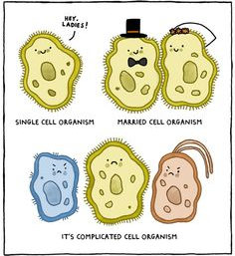
All living things are made up of cells…
The cell is the smallest unit of a living things
If an organism is unicellular, all functions of life happen within that one cell.
If an organism is multicellular, different cells have different jobs and they all work together.

Slide 7
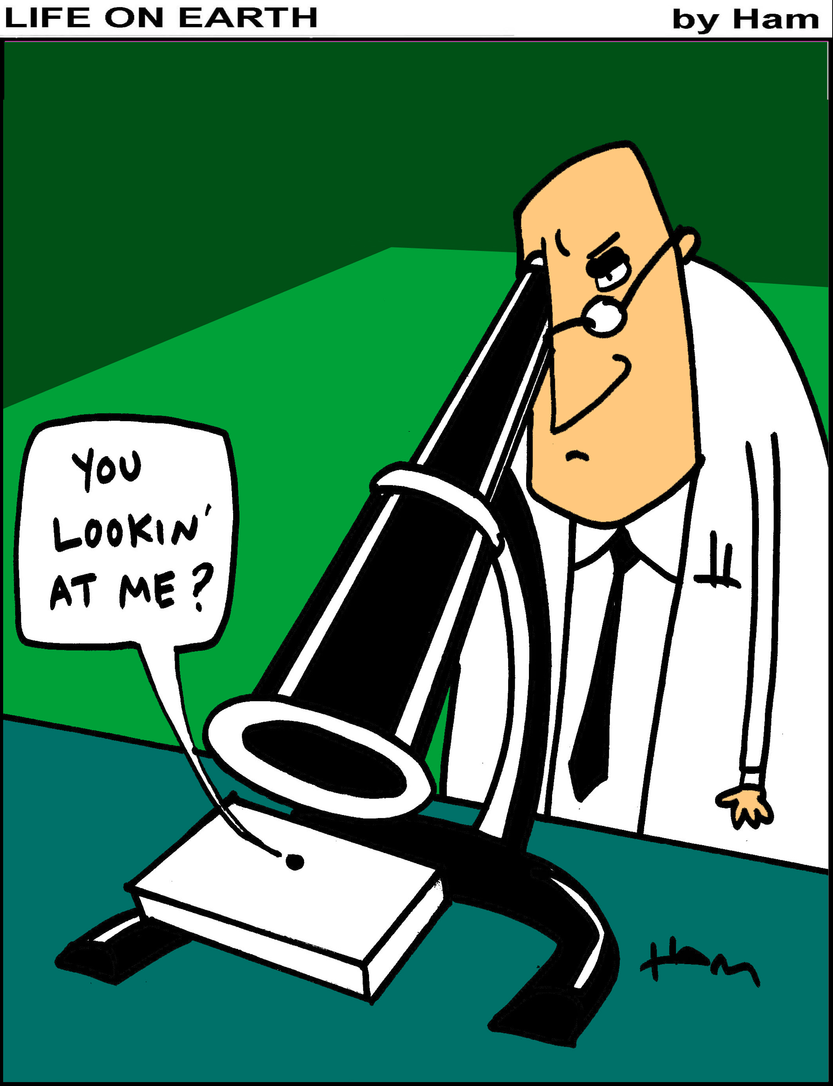
The microscope led to the discovery of cells
1660’s – Robert Hooke discovered the cell
Looked at a piece of cork under the microscope at 30x magnification
Noticed little compartments that he named cells
1670’s – Anton von Leeuwenhook described microorganisms in pond water
Looked at pond water at 300x magnification
Noticed that the water was full of moving things

Slide 8
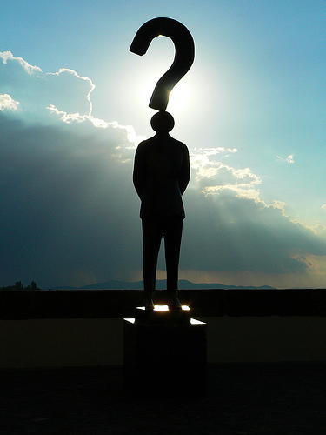
Cell theory
Invention of microscope + scientists = a very important question
Where do cells come from?
This question led to the formation of the Cell Theory

Slide 9
3 parts of the cell theory
Every living thing is made up of one or more cells
Cells carry out the functions needed to support life
Cells come only from other living cells

