Slide 1
Cell Growth Limits
and Cell Cycle

Slide 2
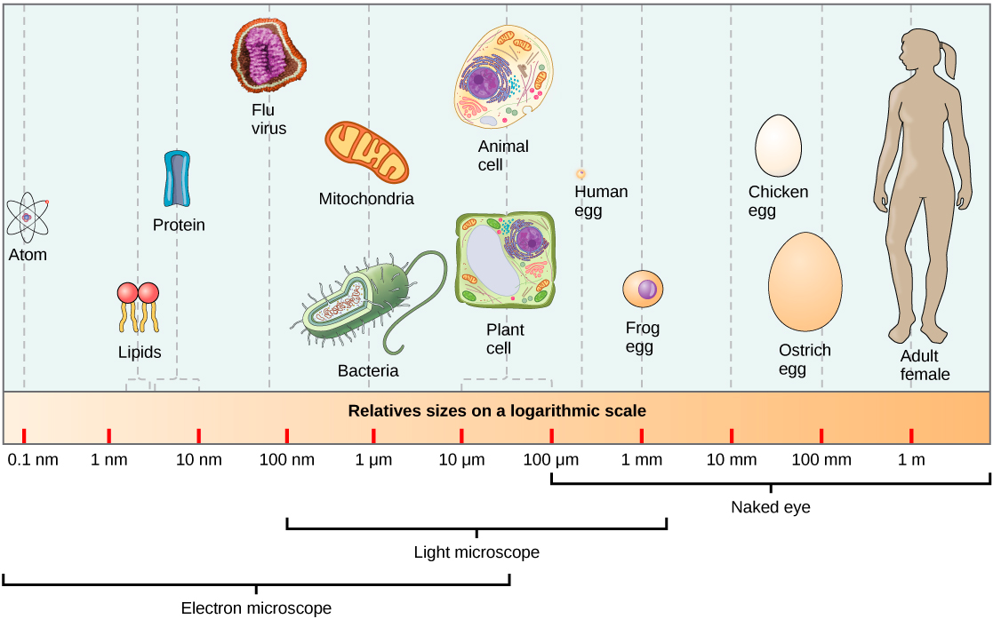
Limits to Cell Size
Most cells are less than 100µm (micrometers) which is smaller than a period on your paper.
The key factor to why cells are so small is the ratio between the surface area and the volume.

Slide 3
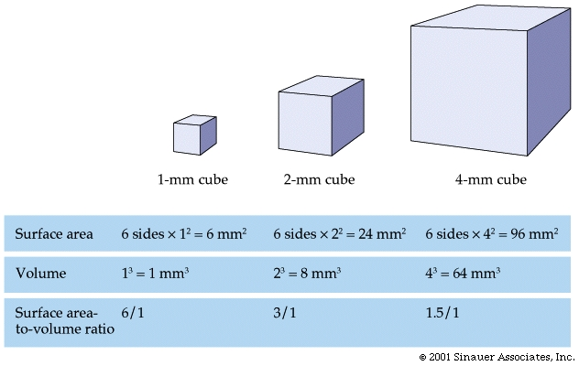
Surface Area vs. Volume
Surface Area = Total area of the surface of a 3D object
Volume = the amount of space occupied by an obhect

Slide 4
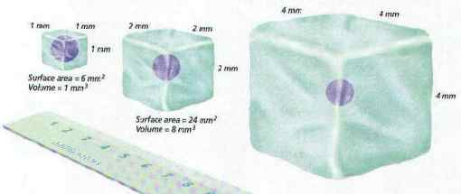
Limits to Cell Size
The surface of a cell is covered by the cell membrane and allows nutrients and waste enter/exit the cell.
If the cell is too big, the diffusion inside the cell is slow and inefficient so the cell parts will not get all the things they need to function.

Slide 5
More Limits
Cells also need to communicate with all of their organelles and other cells, if the volume of a cell is too big the communication can take to long and the cell will die.

Slide 6
The Cell Cycle
Once a cell reaches it’s size limit it has to divide or stop growing. Most divide.
The cell dividing is also a way for the cell to reproduce and heal.
Every time a cell goes through the cycle, it will become 2 cells.

Slide 7
3 Stages of the Cell Cycle
There are 3 main stages:
Interphase- this where the cell grows, carries out it functions, and makes copies of its DNA.
Mitosis- the cell’s nucleus and DNA divides.
Cytokinesis- the division of the cytoplasm and all organelles.
The cell cycle can take as little as 8 hours or as long as a year but most cells go thru it in 12-24 hrs.

Slide 9
Stages of Interphase
Interphase is the part of the cell cycle where the cell grows and replicates and this is broken down into 3 phase.
Gap 1 or G_{1.}
Synthesis or S .
Gap 2 or G_{2.}

Slide 10
Gap 1 (G₁) Phase
G₁ phase happens directly after the cell divides.
It is where the cell grows and carries out normal cell functions
Some cells exit the cycle at this phase and never reproduce like muscle and nerve cells.

Slide 11
Synthesis (S) Phase
The synthesis (S) phase is where the cell replicates it DNA.
DNA doubles at this phase.

Slide 12
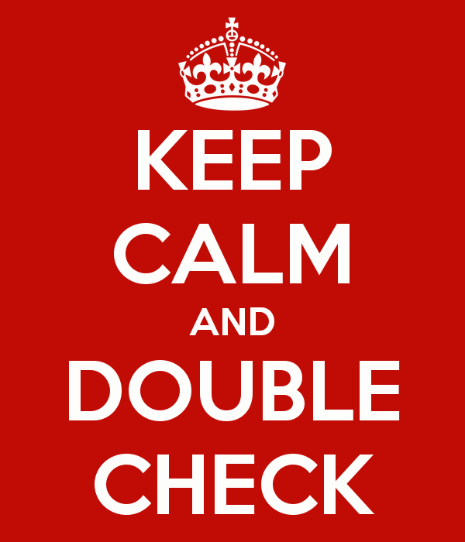
Gap 2 (G2) Phase
In the G₂ phase the nucleus gets ready for dividing.
It double checks to make sure there are 2 copies of everything.
After this phase the cell enters mitosis and cytokinesis.

