Slide 1
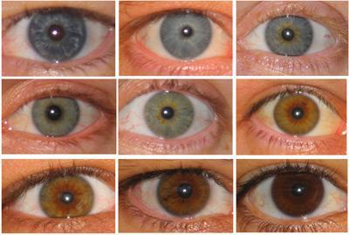
Polygenetic traits
Traits that are influenced by more than one gene.
Ex. Skin color and Eye color

Slide 2
Eye color
There are three basic eye colors.
1. Brown – a lot of melanin pigment
2. Red- no melanin and we see the blood.
3. Blue- a small amount of melanin in the lower layer of the iris which reflects blue light waves.
This does not explain the variations of colors.
So it can’t be that simple!

Slide 3
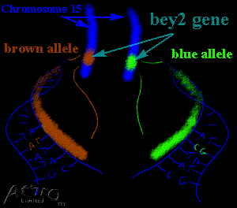
Eye color
There are at least three genes responsible for eye color.
Chromosome 15 - bey 2 Brown/blue
Chromosome 15 - bey 1 Brown/nothing
Chromosome 19 - gey Green/blue

Slide 4
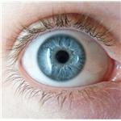
Blue Eyes
In order to have blue eyes you need to have all three genes indicate blue or nothing.
bey 2 - Brown/blue blue
bey 1 - Brown or nothing nothing
gey - Green/blue blue

Slide 5
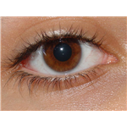
Brown eyes
Individuals with Brown eyes have one of the three genes expressing brown. IF one is brown, it will mask the other colors
bey 2 - Brown/blue blue
bey 1 - Brown or not brown
gey - Green/blue green

Slide 6
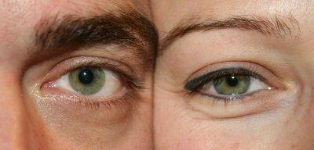
Green eyes
For green eyes, the two brown genes are not expressed and the green gene is present.
bey 2 - Brown/blue blue
bey 1 - Brown or nothing nothing
gey - Green/blue Green

Slide 7
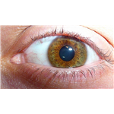
Other colors
Scientists are not sure exactly how to get hazel but this is their latest idea.
They gey gene has a second gene which modifies the amount of melanin produced.
M= modifier
MM or Mm will produce hazel eyes
mm will produce green eyes

Slide 8
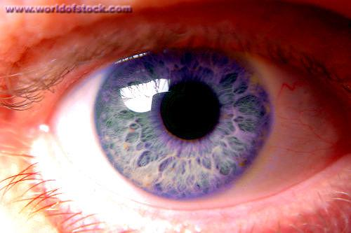
Violet eyes
Genetically similar to blue eyes
Extremely rare.

Slide 9
Different color eyes
Heterochromia
Both eyes are differently colored or one eye has two different colors.
Many causes: trauma at birth, joining of twins in the womb, etc…

Slide 10
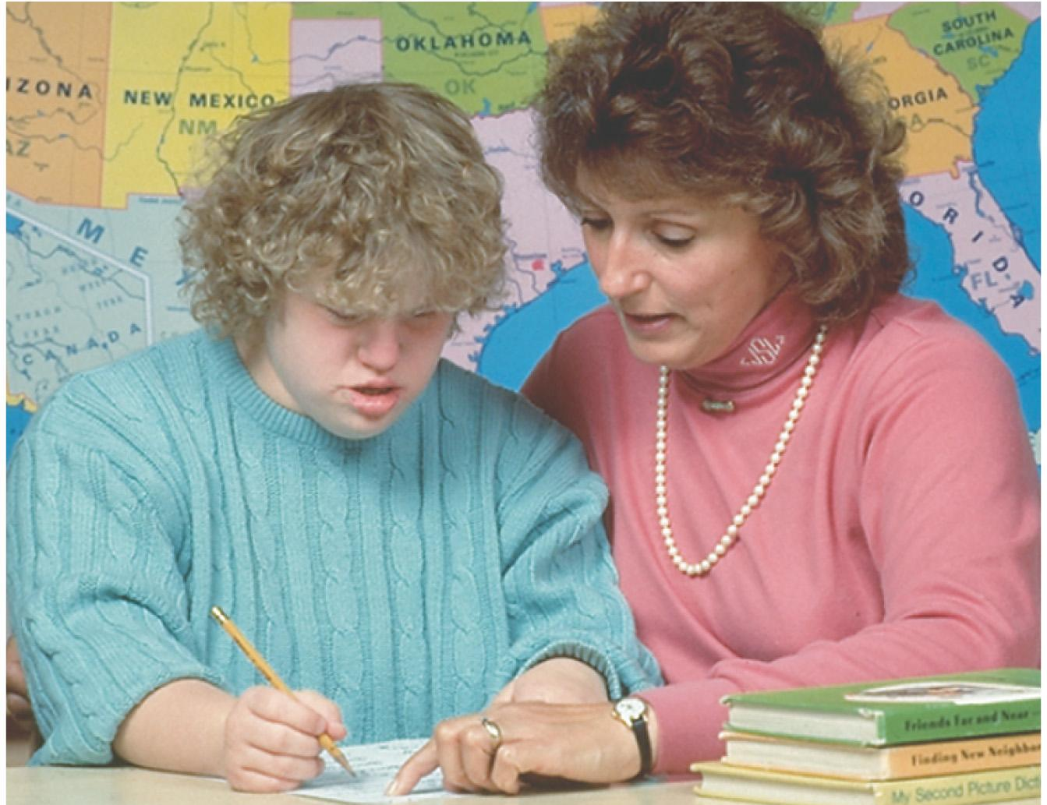
Changes in Chromosome Number
Changes in chromosome number are important for health and evolution.
Down syndrome is caused by a change in chromosome number.

Slide 11
Aneuploidy
Aneuploidy occurs when one of the chromosomes is present in an abnormal number of copies.
Trisomy and monosomy are two forms of aneuploidy.

Slide 12
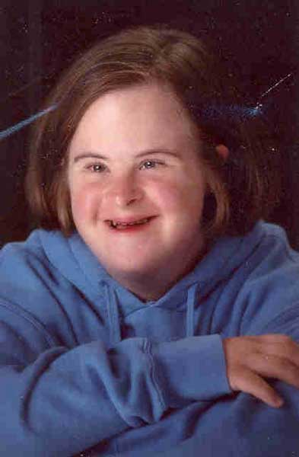
Down Syndrome is Caused by Trisomy for Chromosome 21
Aneuploidy is remarkably common, causing termination of at least 25% of human conceptions.
Aneuploidy is also a driving force in cancer progression (virtually all cancer cells are aneuploid).

Slide 13
Chromosome Non-Disjunction in Meiosis Causes Aneuploidy

Slide 14
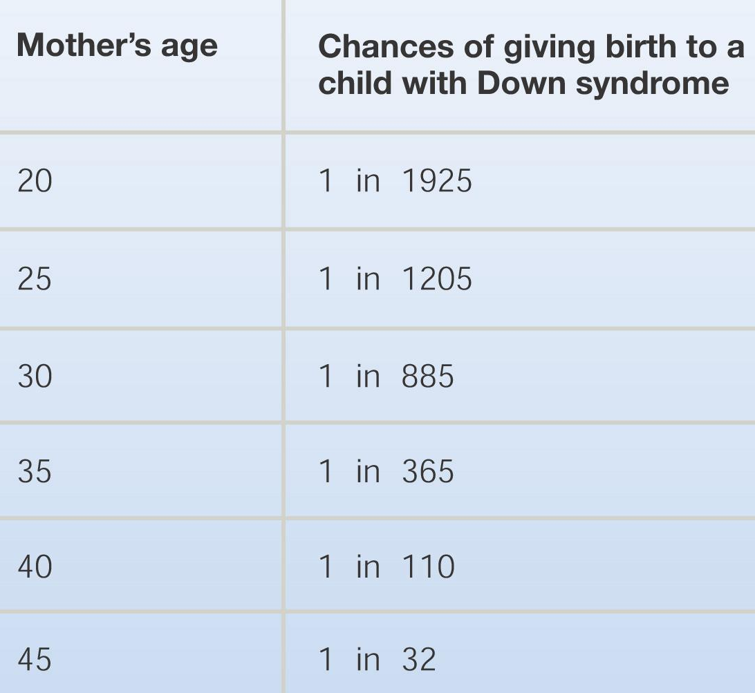
The Frequency of Down Syndrome Rises Sharply with Age of the Mother
The phenomenon is clear – the explanation isn’t.

Slide 15
Sex Chromosome Aneuploid Conditions are Common

Slide 16
Polyploidy
Polyploidy occurs when all the chromosomes are present in three or more copies.
Polyploidy is common in plants and rare in animals.

Slide 17
Polyploids Are Created When Chromosome Number Doubles
A common way for this to occur is for the spindle fibers to fail, leaving all chromosomes in one cell.

Slide 18
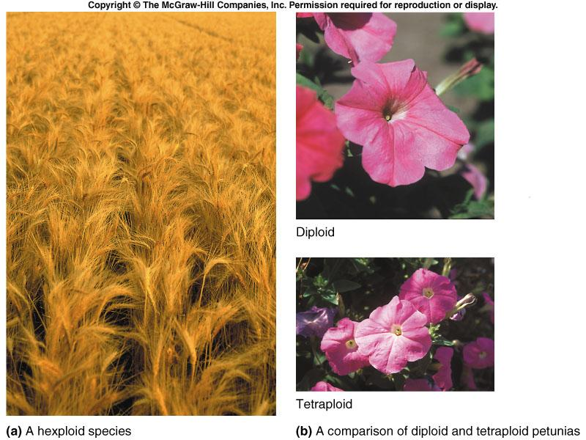
Polyploidy is a Major Force in Plant Evolution
Roughly 35% of flowering plants (the most familiar plant species) arose through polyploidization.

Slide 19
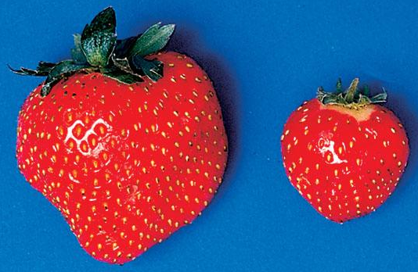
Most Crop Species are Polyploid
Polyploids, like the one on the left, are larger than their diploid progenitors (strawberry on right).

Slide 20
Chromosome Structural Changes
There are 4 types of chromosome structural change – all of them associated with human disorders

Slide 21
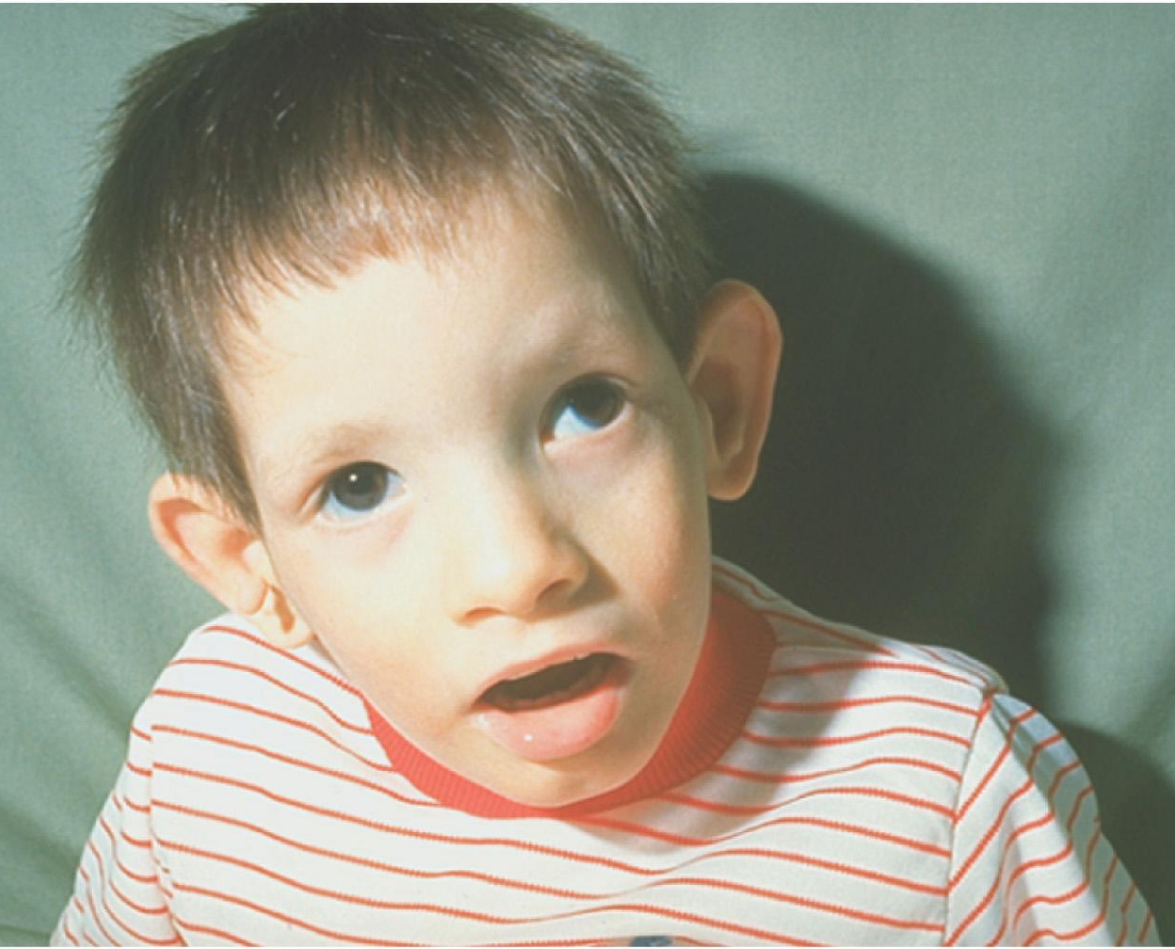
A Boy with Cri-du-Chat Syndrome – a Debilitating Disorder Caused by Chromosome Deletion

Slide 22
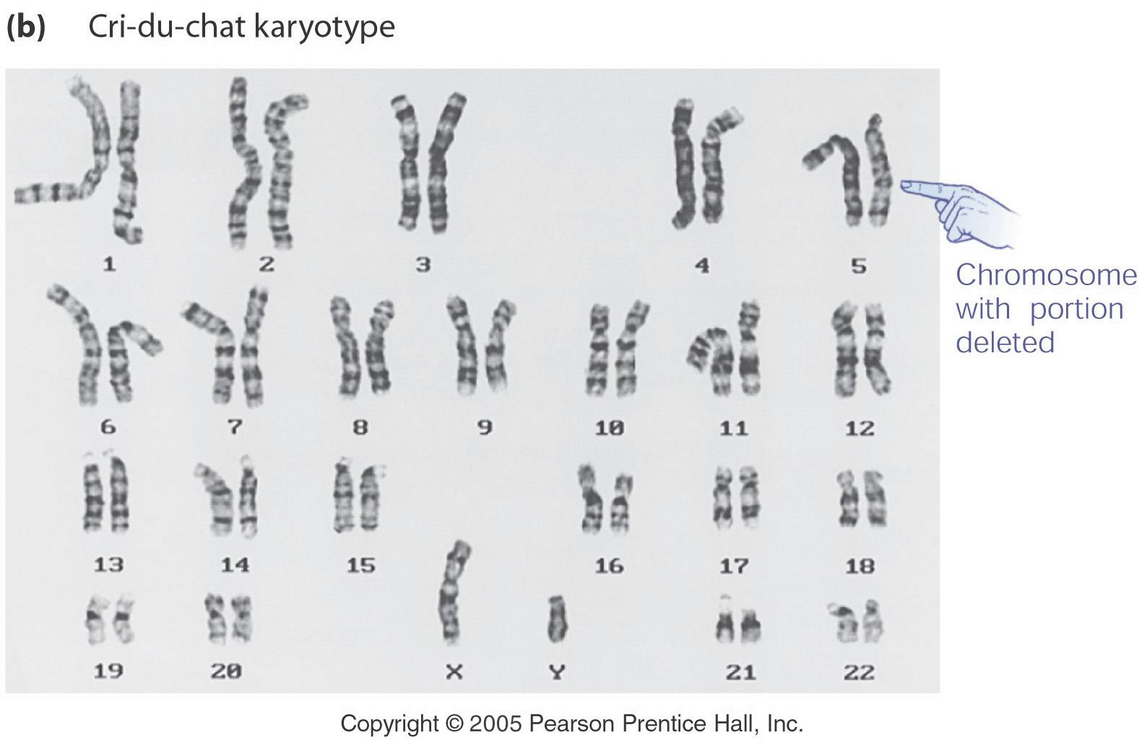
Cri-du-Chat is Caused by the Loss of the Short Arm of One Copy of Chromosome 5

Slide 23
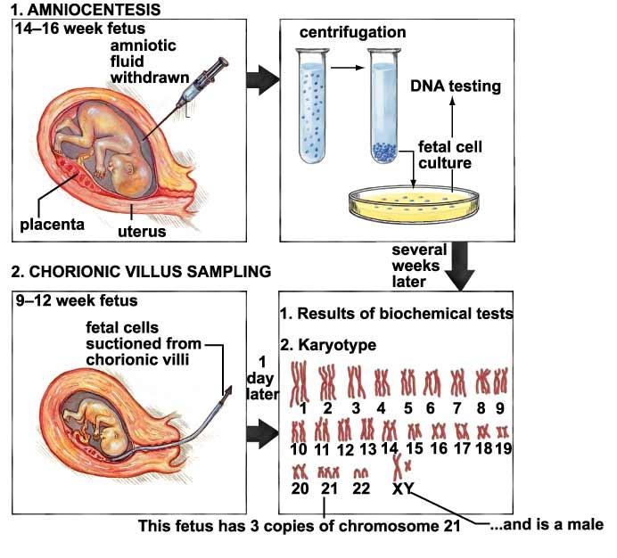
Searching for Chromosomal Defects - Amniocentesis and Chorionic Villus Sampling

Slide 24
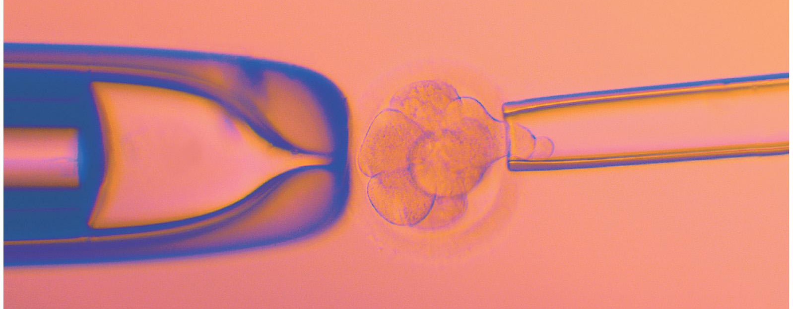
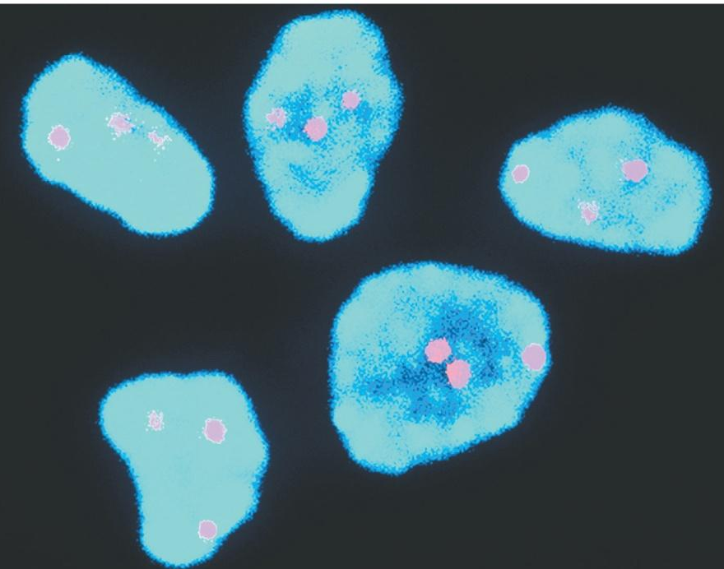
Searching for Chromosome and Gene Defects – Pre-Implantation Genetic Diagnosis (PGD)
Removing a cell for diagnosis from a human embryo.
The diagnosis: trisomy 21 (Down syndrome).

