Slide 1
Translation

Slide 2
Think back!
Transcription
DNA → RNA (with the help of RNA Polymerase)
Ex) A T A C C G T G C A A T C G
U A U G G C A C G U U A G C
RNA is almost the same as DNA
No T’s, U’s instead
Still uses complementary pairs
Called “ribonucleic acid” → single stranded

Slide 3
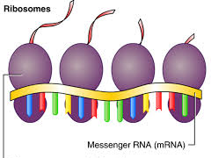
mRNA (messenger RNA) leaves the nucleus with the translated code and moves to the ribosomes
Where proteins are made
Remember, the whole point of all of this is to build proteins!

Slide 4
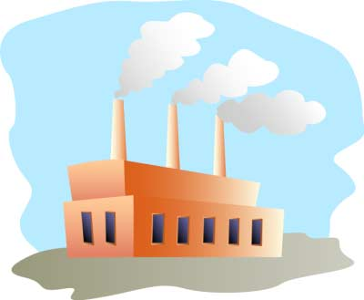
Translation
Once we get to the ribosomes, we refer to this process as translation
we are translating the message in the mRNA into proteins
Think of the ribosome like a factory that produces amino acid chains from the mRNA

Slide 5
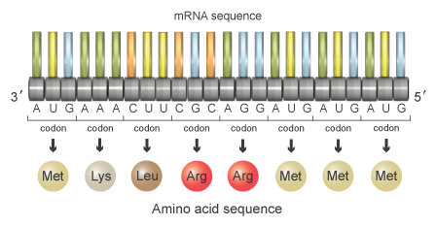
Translation cont.
In the ribosome, the ribosome reads the mRNA in codons (groups of 3) that represent amino acids
Remember, amino acids are the building blocks of proteins

Slide 6
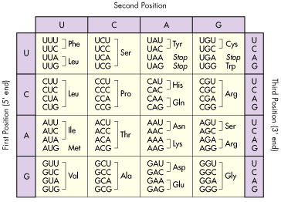

Slide 7
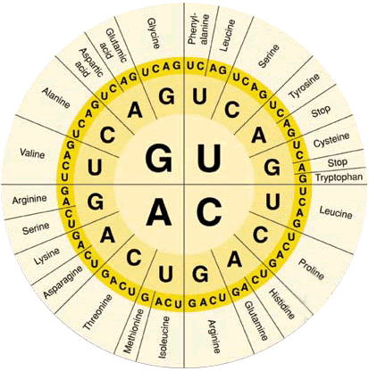

Slide 8
Translation cont.
Ex) mRNA: UCU
amino acid:
Ex) mRNA: CCG
amino acid:
Ex) mRNA: UUA
amino acid: _ _ _

Slide 9
Translation cont.
Once the ribosome codes for a section of mRNA, it releases the amino acid it has been holding on to
As more amino acids are coded for, they all connect to each other by peptide bonds

Slide 10
Translation cont.
This process starts with a “start codon” and ends with a “stop codon”
start: AUG
stop: UAA, UAG, UGA

Slide 11
Peptide bond
Peptide bond

Slide 12
