Slide 1
DNA Transcription

Slide 2
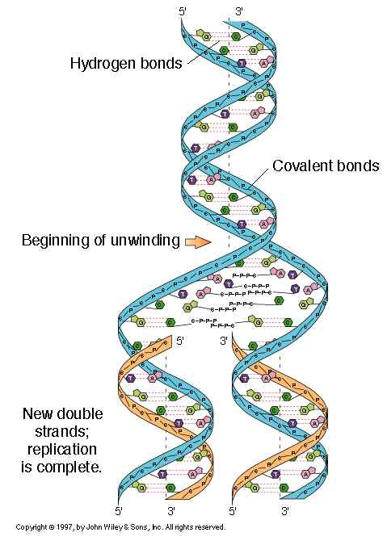
What we’ve done
So far we’ve learned what DNA is made out of and what its roles are, but today we’re going to learn HOW it actually does what it does

Slide 3
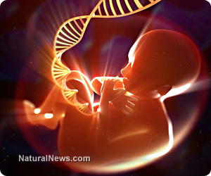
How does this all work?
In order for our bodies to look a certain way or function a certain way, our DNA must code for these genes and traits

Slide 4
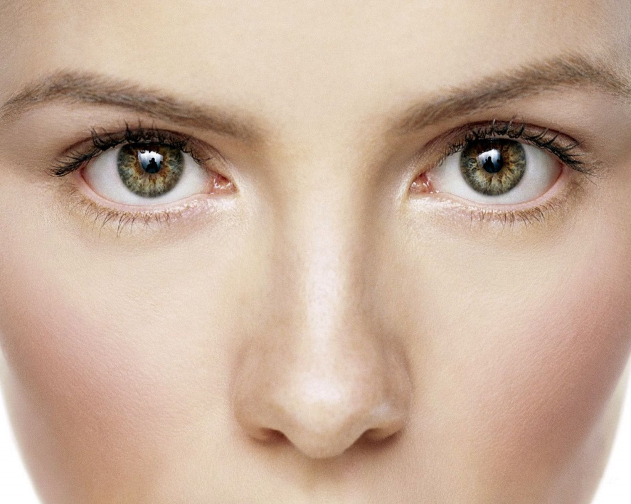
When our DNA codes for genes and traits (through sequences of T’s, A’s, G’s, and C’s), our DNA is actually coding for proteins that will make us who we are
ex) the proteins that build our nose
ex) the proteins that produce melanin for our eyes/hair
This is called protein synthesis

Slide 5
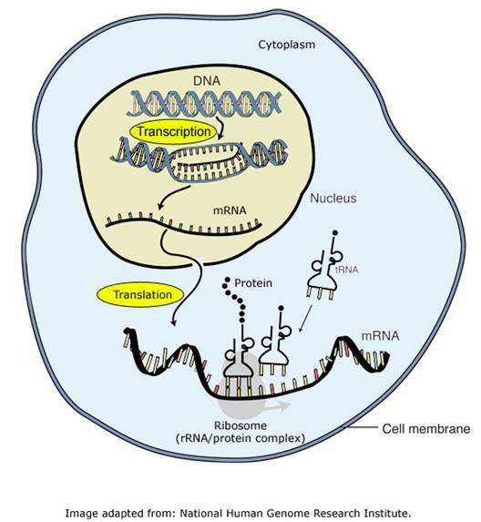
Protein Synthesis
There are two major parts of protein synthesis
Transcription
Translation
Today, we will learn about the first part, transcription

Slide 6
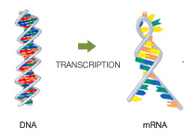
Transcription Made Easy
Think of transcription as “transcribing” or translating the DNA into a message
The “message” will leave the nucleus to the ribosomes on a piece of mRNA, or messenger RNA
Remember, ribosomes make proteins!

Slide 7
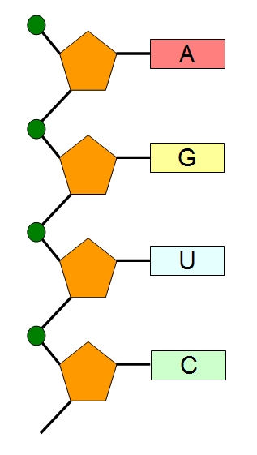
Wait, what’s this RNA stuff?
RNA is very similar to DNA, except the sugar is called ribose, and it is only a single strand
RNA has the same bases, except instead of T, there is U (uracil)
A → U
G → C

Slide 8
DNA → RNA
mRNA gets created as a complementary strand to the DNA
Before, A would pair with T, but now A pairs with U
RNA Polymerase helps out
The T’s on the DNA strand will still pair with A’s
Ex) DNA strand: A T T G A C
RNA strand: U A A C U G

Slide 9
PRACTICE

Slide 10
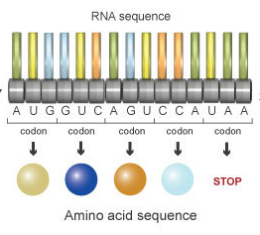
mRNA
mRNA gets read in groups of three, also known as codons
Ex) U A A C U G
UAA CUG
These codons code for amino acids
Which are the building blocks of proteins!

Slide 11
PRACTICE

