Slide 1
DNA REPLICATION

Slide 3
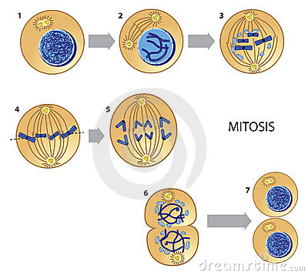
DNA Replication 101
Original DNA strand acts as template for new
It is important for the new cell to be an exact copy of the original
the new cell’s genetic information will affect how it directs the structure and function of the new cell

Slide 4
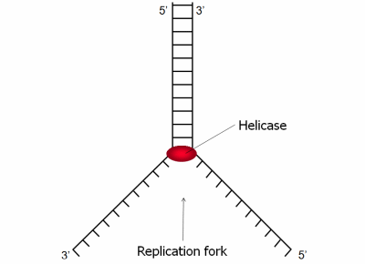
DNA Replication 101
Step 1:
Parent DNA strand starts to “unzip”
weak hydrogen bonds between nucleotides split, forming the replication fork
The enzyme, DNA helicase, helps this “unzipping” process

Slide 5
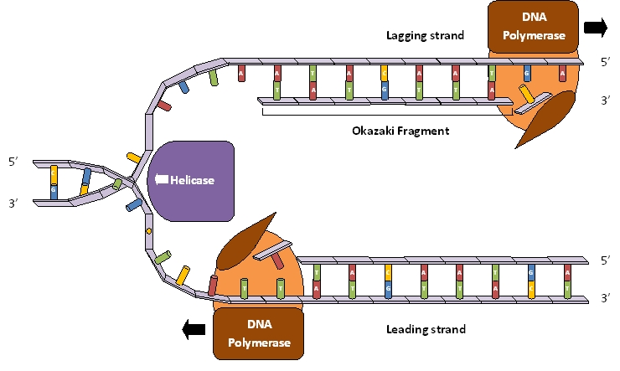
DNA Repliction101
Step 2
DNA polymerase helps free base pairs bind with their complementary base pairs on the parent strands
complementary: fitting together properly
T → A
G → C

Slide 6
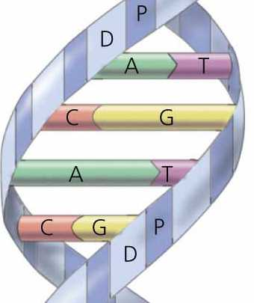
Complementary

Slide 7
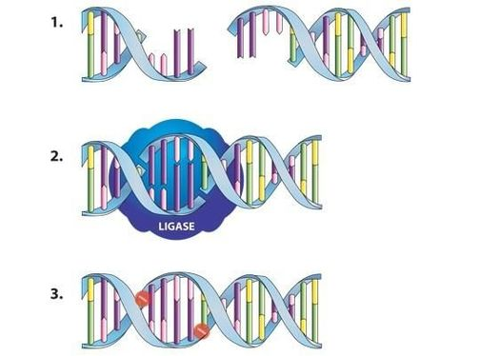
DNA Replication 101
http://www.biotechlearn.org.nz/themes/dna_lab/images/dna_ligation
Step 3
DNA ligase follows the process and forms covalent bonds in the backbone of the new DNA strand
this ensures that the new strand’s backbone won’t break apart

Slide 8
Let’s watch it!
https://www.youtube.com/watch?v=zdDkiRw1PdU

Slide 9
DNA Replication Activity

