Slide 1
EVOLUTION TIMELINE

Slide 2
13.8 bya “The Big Bang”
https://www.youtube.com/watch?v=u0ZP152mALk

Slide 3
4.6 bya “The Solar System”

Slide 4
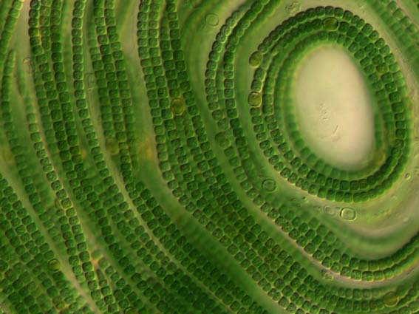
3.5 bya “Origin of Life on Earth”
Oldest Fossil - Stromatolite
made by Cyanobacteria (Blue-green algae)

Slide 5
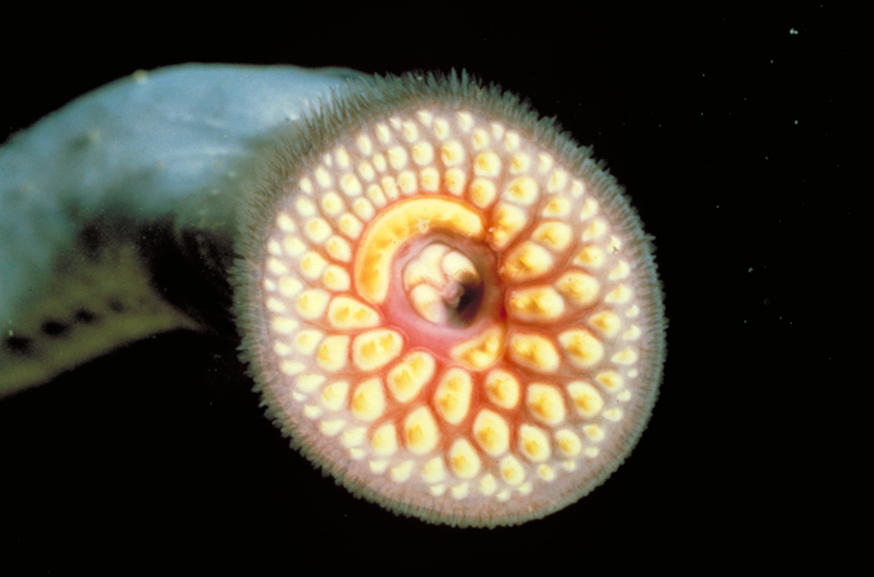
540 mya “First Vertebrates”
Hagfish
Lamprey

Slide 6
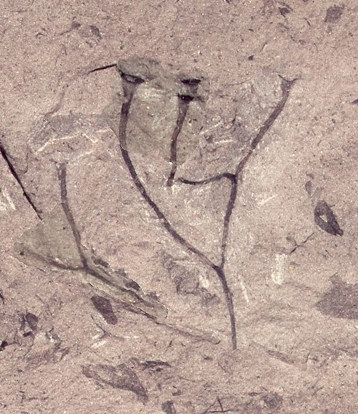
440 mya “First Land Plants”
Cooksonia

Slide 7
220 mya “Origin of Dinosaurs”

Slide 8
65 mya “Extinction of Dinosaurs”

Slide 9
30 mya “First Apes”

Slide 10
300,000 ya “First Homo sapiens”

