Slide 1
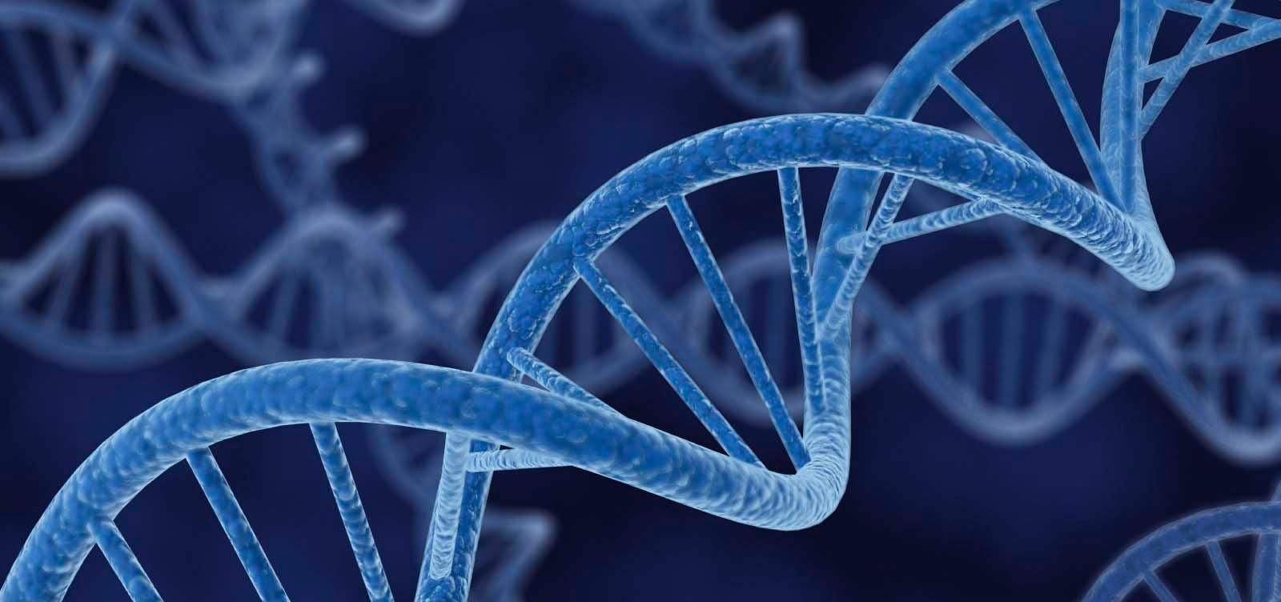
DNA

Slide 2
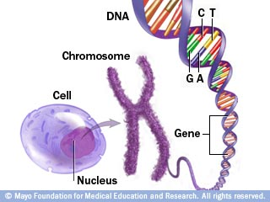
What is this DNA stuff anyway?
Deoxyribonucleic Acid
Makes up the chromosomes of every living organism
Chromosomes found in the nucleus of every cell
Remember mitosis!

Slide 3
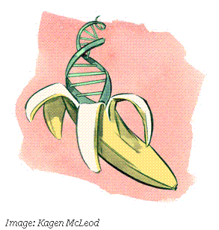
What does DNA do?
Controls what kind of cell a cell can become
Ex) muscle cell, skin cell, reproductive cell
Controls what kind of organism something is
Ex) blue whale, human, scorpion, banana
Controls what the organism looks like
Makes up the genes that make up the organism

Slide 4
What is DNA made of?
Super long molecule made out of smaller parts
A single small part = nucleotide
A nucleotide is made out of:
1 sugar called deoxyribose
1 phosphate group
1 nitrogenous base
These all line up end to end to make a DNA strand in the form of a double helix

Slide 5
Single nucleotide
Many nucleotides attached

Slide 6
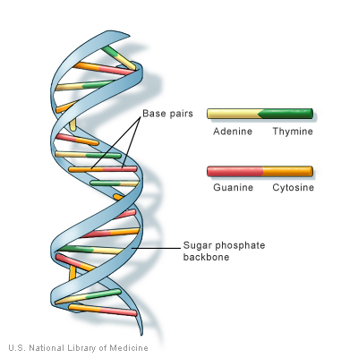
Nucleotides connect end to end by covalent bonds along the sugar-phosphate backbone
Strong!
Two separate strands form, connected to each other by their bases
Hydrogen bonds
Weak!
Forms the double helix formation

Slide 7
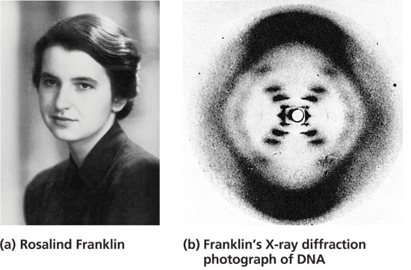
Franklin, Watson, and Crick
Before we knew the double helix structure of DNA, a British scientist named Rosalind Franklin used process called X-ray diffraction to try to get a clear picture of how DNA was structured

Slide 8
Franklin, Watson, and Crick
X-ray picture helped scientists a lot, but still left some aspect of the structure of DNA unclear
After messing around with a model made of cardboard and wire, two scientists named James Watson and Francis Crick realized the twisting double helix structure was the missing piece!

Slide 9
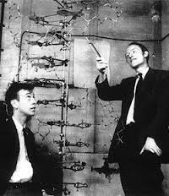

Slide 10
Base Pairs
Nitrogenous bases come in pairs
Adenine Thymine
Guanine Cytosine
Adenine and Guanine are both organic compounds referred to as purines
Thymine and Cytosine are both organic compounds referred to as pyrimidines
Chargaff’s Rule:
Only A and T can bond
Only G and C can bond

