Slide 1
Intro to Anatomy & Physiology

Slide 2
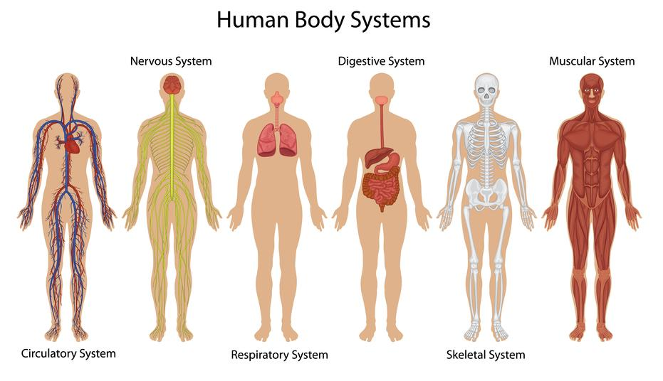
Human Body Plan
Many organ systems make up the human body
Each organ system has a special relationship to all the other organ systems
STRUCTURE → FUNCTION
They all work together and are interconnected!

Slide 3
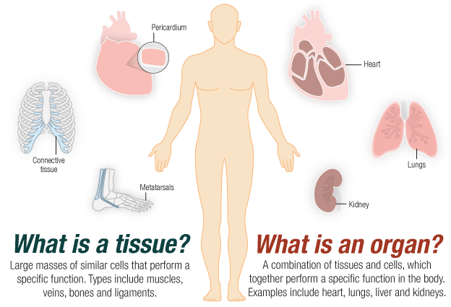
Organs
Organs are made up of various tissues that work together to help the organ with its specific function

Slide 4
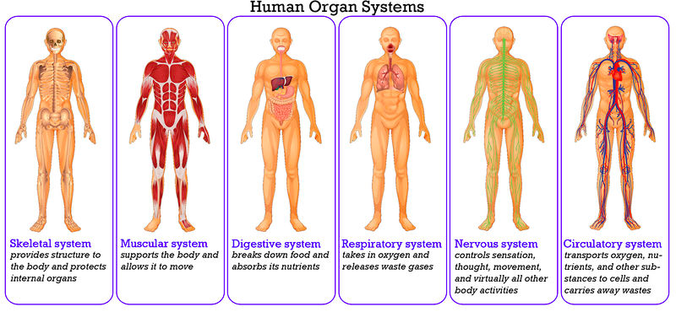
Organ Systems
Organs do not work efficiently on their own, but rather together with other organs in a “system”
Systems work together to make the body function properly (digestive system, circulatory system …)

Slide 5
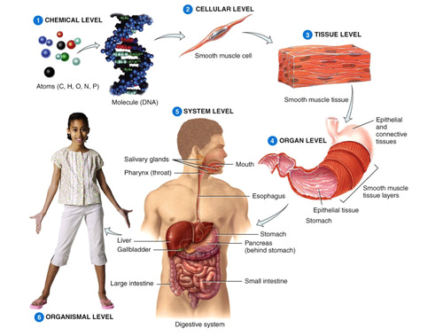
Organization
Cells → tissues → organs → organ systems → body
Organized in specific locations and body cavities

Slide 6
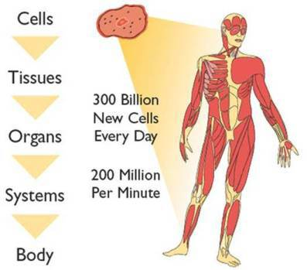

Slide 7
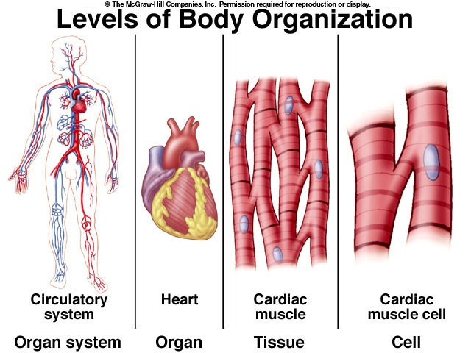

Slide 8
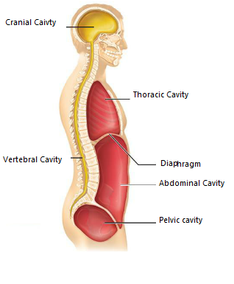
Body Cavities
Body cavities “organize” organs and organ systems
Cranial – brain
Spinal – surrounds spinal cord
Thoracic – upper trunk (chest)
Abdominal – lower trunk (gut)
Thoracic and abdominal cavity separated by the diaphragm
Pelvic – contains reproductive and excretory organs

Slide 9
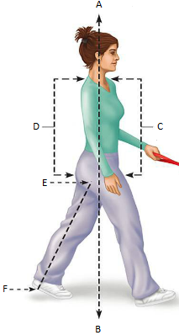
Orientation
A: Superior
B: Inferior
C: Anterior
Ventral in four legged animals
D: Posterior
Dorsal in four legged animals
E: Proximal/Medial
F: Distal/Lateral
G: Cranial
H: Caudal

